Slide 1
Power Point Template Title Slide: Option1
Children’s logo and Emory University Logo

Slide 2
Title Slide: Option 2 use when a photo is needed on the title slide

Slide 3
Title
Text: 28 pt font

Slide 5
Comparison List
List A
List B
A 1
A 2
B 1
B 2

Slide 6
Title: 36 pt
Insert key fact connected with photo
Insert
Photo

Slide 7
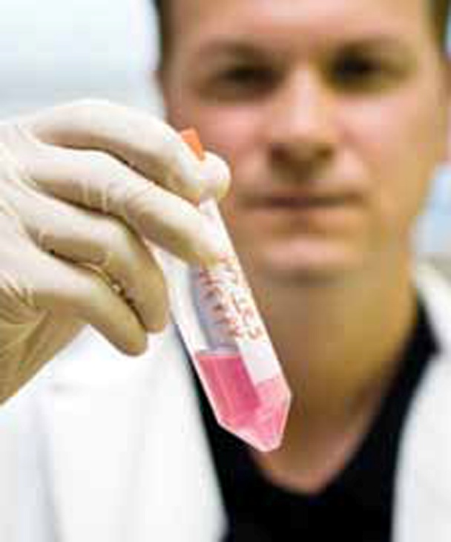
Photo + Overlaid Text
(with area for description)
Convergence of passion, culture, medicine,
technology and engineering
COLLABORATION

Slide 8
Divider Slide

Slide 9
FOR ONSCREEN ONLY
Divider Slide

