Slide 1
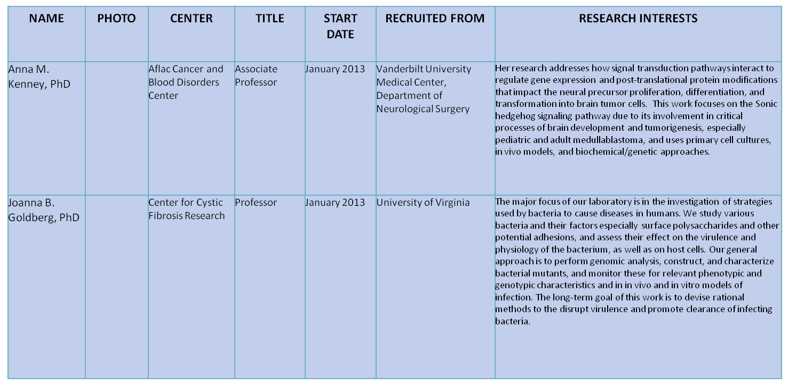
Research Recruitment Update:
Research Update February 2013
Notes:
1

Slide 2
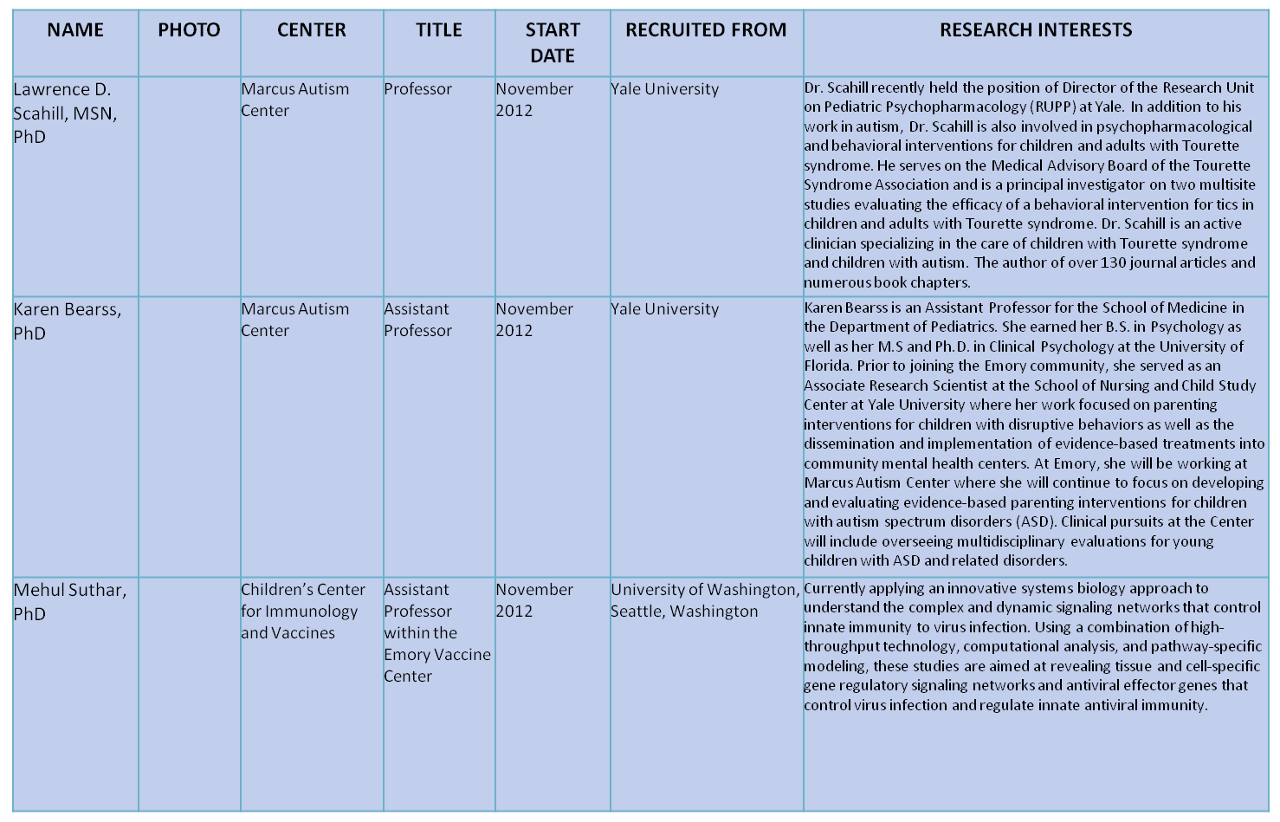
Research Recruitment Update (continued):
Research Update February 2013
Notes:
2

Slide 3
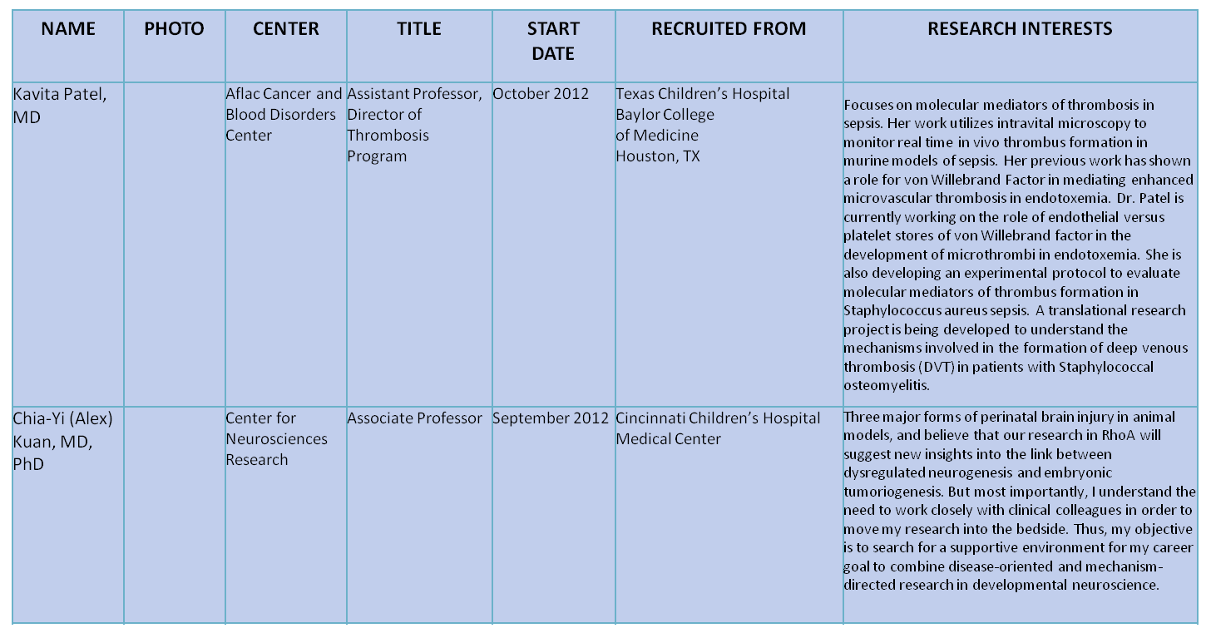
Research Recruitment Update (continued):
Research Update February 2013
Notes:
3

Slide 4
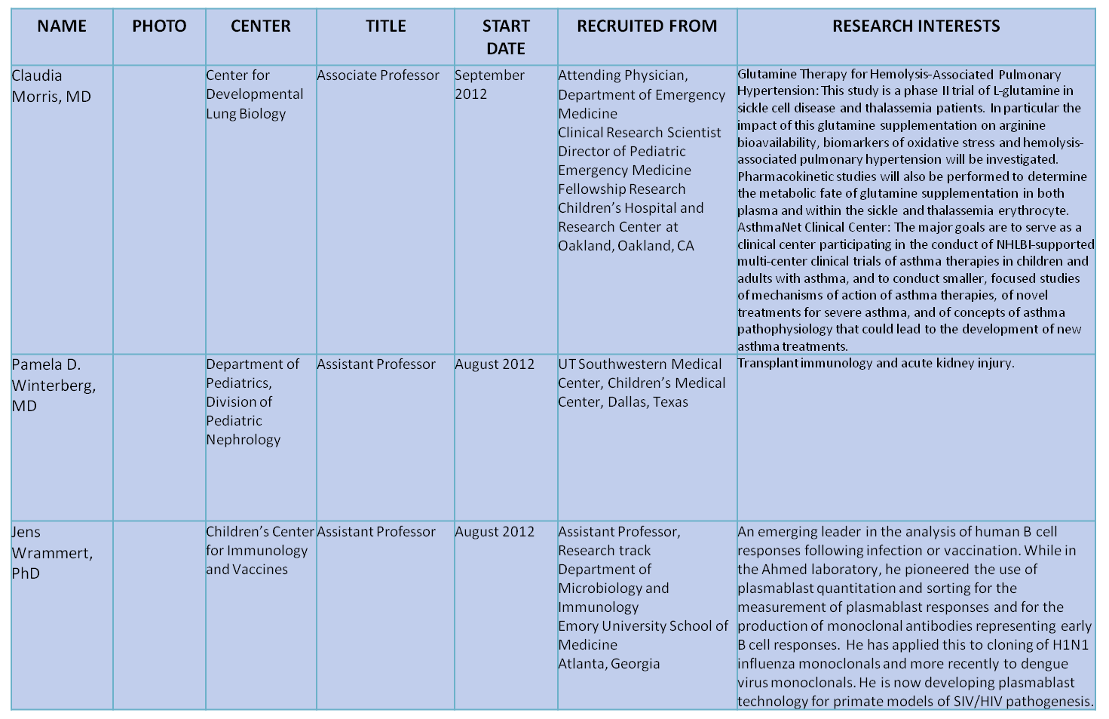
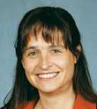
Research Recruitment Update (continued):
Research Update February 2013
Notes:
4

Slide 5
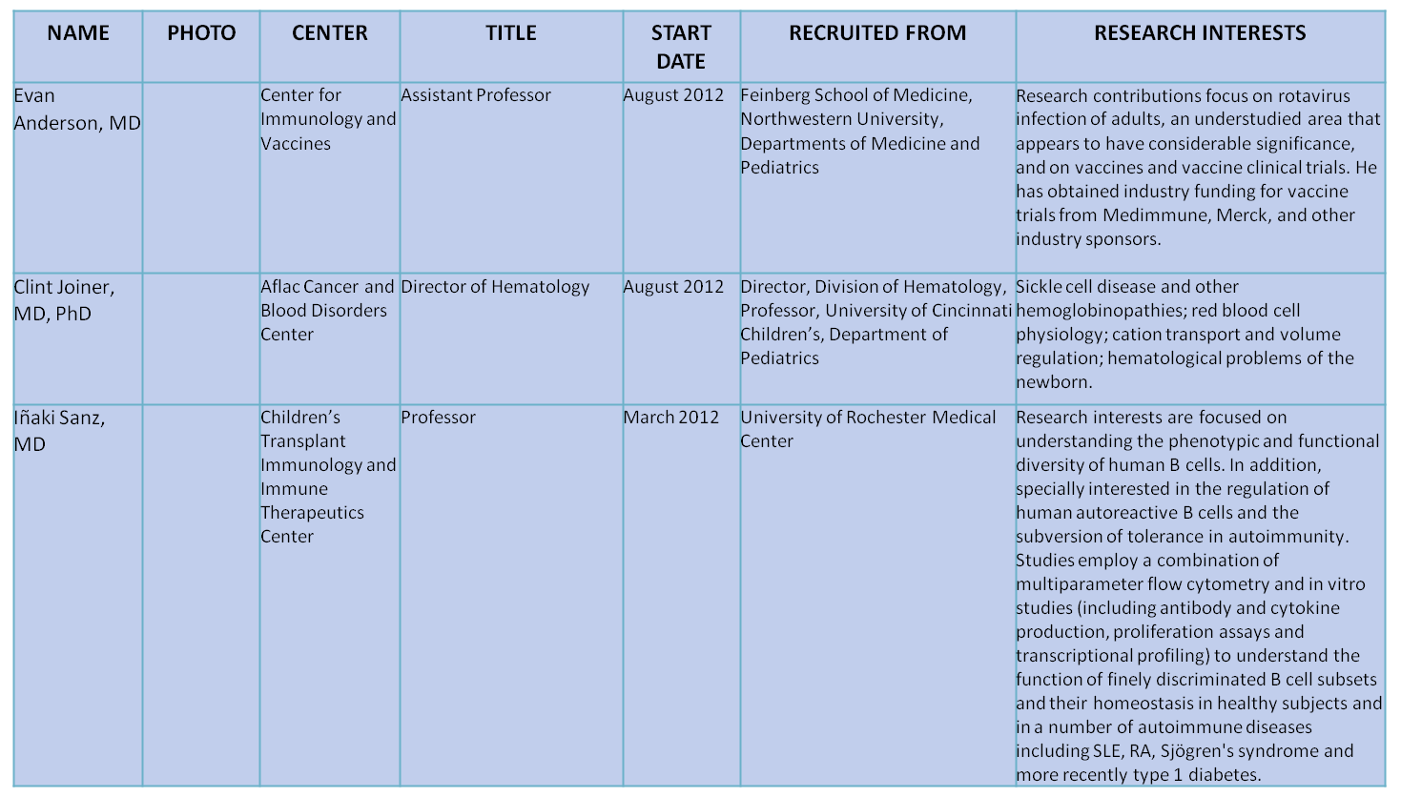
Research Recruitment Update (continued):
Research Update February 2013
Notes:
5

