Slide 1
Emory+Children’s Pediatric Research Center Update December 2013
Grant and Manuscript Support
Stacy Heilman, PhD Grants Advocate (404-727-4819, stacy.heilman@emory.edu)
Assistance with finding grant opportunities and connecting to collaborators
Core laboratory assistance, supervision
Clinical studies/
coordinators
Kris Rogers, RN, CRA Director, Clinical Research: (404-785-1215, Kristine.rogers@choa.org
  Manager, Egleston campus: Allison Wellons (404-785-6459, Allison.wellons@choa.org)
Common Equipment/
Specimen Processing Core
2nd floor ECC 260 lab:
Technical Director:
Yelena Blinder ybesnov@emory.edu
Research Resources:
The resources to the right are available to all investigators affiliated with Children’s Healthcare of Atlanta (CHOA), including medical staff, Emory Department of Pediatrics (DOP) faculty and staff, and those outside of the DOP and CHOA who are members of our research centers. We encourage involvement of all those interested in research throughout our system, and provide this as a guide to resources along with our research website www.pedsresearch.org . Our goals are to build infrastructure and programs that serve a broad community of scientists and clinicians engaged in pediatric research, and provide training in grant writing and grant opportunities that enhance our extramural funding for all child health investigators affiliated with Children’s Healthcare of Atlanta. For suggestions and comments on any of the initiatives and resources, please contact Paul Spearman, MD (paul.spearman@emory.edu).
Grants & Manuscript Editing
Prioritized for extramural funding opportunities, program projects
Experienced at program project management, grant and scientific paper editing
Request form on pedsresearch.org; send to Stacy Heilman.
Manager, Hughes Spalding/Scottish Rite campuses: Beena Desai
(404-785-2269, beena.desai@choa.org)
  Nurse Manager, Pediatric Research Unit (Egleston): Stephanie Meisner, RN
  Stephanie.Meisner@choa.org
  (404-785-0400-main number)
Equipment: Biosafety cabinet, incubators, clinical centrifuge, real-time PCR machine, standard PCR machine, multilabel plate reader, gel documentation system on order
Services: this core provides common equipment for investigator’s use, including access to benchtop space and hood space, centrifuges for clinical specimen processing
Research Resources
Biostatistics Core
Traci Leong, PhD
Courtney McCracken, PhD
Scott Gillespie, MS
Procedure: Request form located at http://www.pedsresearch.org/cores/detail/biostats
Priorities: analysis for grant
applications and
publications
Pediatric Research Unit (Egleston):
  Services: The Research Department manages clinical coordinators and research nurses centrally, and provides training in research procedures and compliance. As needs grow or new grants are obtained, new personnel are hired who report to Kris Rogers and to the natural supervisor (grant PI, service line chief, division director).
Laboratory Specimen Processing: Egleston
Manager: Diana Worthington-White (404-785-1721 diana.worthington-white@choa.org
Clinical trials specimen processing, shipping, limited storage
ACTSI processing lab
Laboratory inventory management system (LIMS) available
Notes:
1

Slide 2
Research Leadership:
Research Operations Council (ROC)
Patrick Frias
Chief, Children’s
Physician Group
Barbara Stoll
Chief , Department of Pediatrics
Tom Brems
Liz McCarty
Clinical Administrator
TBN
Finance
Paul Spearman
Chief Research Officer
Kris Rogers
Director, Clinical Research
Stacy Heilman
Grants Advocate, Cores
Barbara Kilbourne
Manager, Business Operations
Research Advisory Council
(RAC)
Research Center Directors
Nursing Research
Other Pediatric Research Leaders from
Emory, Ga Tech, Morehouse
Biostats Core
GEMS Core
Research Managers,
Research Coordinators
Center Program Coordinators
Research Update December 2013
Notes:
2

Slide 3
Emory+Children’s Pediatric Research Centers*
Pediatric Nanomedicine
Cardiovascular
Biology
Marcus
Autism Center
Neurosciences
Pediatric Innovation
Drug Discovery
Immunology and Vaccines
Clinical Outcomes Research and Public Health
Transplantation & Immune-mediated Disorders
Aflac Cancer Center
Center for CF and Airways Disease Research
*For more information, please see center WebPages
Research Update December 2013
Notes:
3

Slide 4
Center in Development:
Clinical/Translational Research Center
(New leader to be recruited)
  Organize pediatric clinical research units, ACTSI relationship, research nurse/coordinator pool, and support for multicenter trials networks
  NIH and other extramural funding emphasized, as for all sponsored activities
  Mission: This Center will engage those clinical investigators who perform interventional clinical research, including trials of drugs, devices, and vaccines. The Clinical/Translational Research Center will be the research “home” for clinical investigators throughout the system who are not primarily epidemiologists/outcomes researchers. We envision the leader of this center leading and organizing further the central clinical research resources, including the distribution of research coordinators, managers, and data analysts. Clinical informatics will be a key part of this Center, shared with the Outcomes/Wellness Center.
Research Update December 2013
Notes:
4

Slide 5
Emory+Children’s Pediatric Research Center Contacts
Aflac Cancer and Blood
Disorders Center
Center Director: Bill Woods, MD
william.woods@choa.org
Program Coordinator: Linda Campbell linda.campbell@emory.edu
Center for Cardiovascular Biology
Center Director: Mike Davis, PhD michael.davis@bme.gatech.edu
Program Coordinator: Kristen Herzegh, BA, MPH kcoshau@emory.edu
Children’s Center for Clinical and Translational Research
Center Director: TBN
Program Coordinator: Andrea Paul
Tonika.paul@choa.org
Center for Cystic Fibrosis & Airways Disease Research
Center Director: Nael McCarty, PhD
namccar@emory.edu
Program Coordinator: Andrea Paul
Tonika.paul@choa.org
Center for Drug Discovery
Center Director: Baek Kim, PhD
Baek.kim@emory.edu
Program Coordinator: Kristen Herzegh, BA, MPH kcoshau@emory.edu
Center for Immunology and Vaccines
Center Director: Paul Spearman, MD
paul.spearman@emory.edu
Program Coordinator: Kristen Herzegh, BA, MPH kcoshau@emory.edu
Center for Neurosciences Research
Center Director: Ton deGrauw, MD, PhD ton.degrauw@choa.org
Program Coordinator: Jennifer Kenny jkenny@emory.edu
Center for Pediatric Innovation
Center Directors: Bob Guldberg, PhD
and Kevin Maher, MD robert.guldberg@me.gatech.edu and maherk@kidsheart.com
Program Coordinator: Hazel Stevens
hazel.stevens@me.gatech.edu
Center for Pediatric Nanomedicine
Center Director: Gang Bao, PhD
gang.bao@bme.gatech.edu
Senior Manager: Amy Tang
amy.tang@bme.gatech.edu
Program Coordinator: Erin Kirshtein
Erin.kirshtein@bme.gatech.edu
Center for Transplantation & Immune-mediated Disorders
Center Directors: Subra Kugathasan, MD and Allan Kirk, MD, PhD
skugath@emory.edu and adkirk@emory.edu
Program Coordinator: Jennifer Kenny jkenny@emory.edu
Clinical Outcomes
Research and Public Health
Center Director: Paul Spearman, MD (Acting)
paul.spearman@emory.edu
Program Coordinator: Andrea Paul
Tonika.paul@choa.org
Marcus Autism Center
Center Director: Ami Klin, PhD
Director of Research: Warren Jones, PhD ami.klin@emory.edu or
ami.klin@choa.org and warren.r.jones@choa.org
Program Coordinator: Barbara Kilbourne barbara.kilbourne@choa.org
Research Center Administration:
Barbara J. Stoll, MD
George W. Brumley, Jr. Professor and Chair Department of Pediatrics
Emory University School of Medicine
President, Emory Children's Center
Director, The Pediatric Center of Georgia
barbara_stoll@oz.ped.emory.edu
Patrick Frias, MD
Chief, Children’s Physician Group
Children’s Healthcare of Atlanta
Paul Spearman, MD
Nahmias-Schinazi Professor and Chief, Pediatric Infectious Diseases
Chief Research Officer, Children’s Healthcare of Atlanta
Vice Chair for Research, Department of Pediatrics, Emory University
paul.spearman@emory.edu
Kris Rogers, RN, CRA
Director of Research & Graduate Medical Education
Children's Healthcare of Atlanta
kristine.rogers@choa.org
Liz McCarty
Clinical Administrator
Department of Pediatrics, Emory University
mmccar2@emory.edu
TBN
Director of Finance, Academic Administration
Children's Healthcare of Atlanta
Stacy S. Heilman, PhD
Director of Programs & Grants Advocate
Department of Pediatrics, Emory University &
Children's Healthcare of Atlanta
stacy.heilman@emory.edu
Barbara W. Kilbourne, RN, MPH
Manager, Business Operations
Research Strategy Leadership
Children's Healthcare of Atlanta
barbara.kilbourne@choa.org
Center Directors:

Slide 6
Research-sponsored events/meetings:
(This is an overview, for specific dates/events, go to: http://www.pedsresearch.org/calendar )
MONDAYS | TUESDAYS | WEDNESDAYS | THURSDAYS | FRIDAYS | VARIOUS DAYS
Research Operations Council (ROC) meetings: occurs weekly at Egleston, 1st Floor Admin Boardroom. Designed for central team to discuss detailed operations and issues. |  | Research Brainstorming Sessions: Help as needed to allow development and exploration of special research topics. For suggested topic nominations, contact (Stacy.heilman@emory.edu) |  | PeRCS: 10 AM coffee social every 1st and 3rd Friday, usually held 3rd floor break area, E-CC | Research Advisory Council (RAC) meetings: twice monthly; restricted to RAC membership, contact Paul Spearman for inquiries or suggestions paul.spearman@emory.edu
K club: Monthly discussions/lectures for K award training, other grants training/education. Typically 2nd Monday, September to May, Contact Stacy Heilman (Stacy.heilman@emory.edu) for more information. Sponsored by Departments of Pediatrics and Medicine and ACTSI. |  | Research Grand Rounds: 3rd Wednesday of month, Egleston, 7:30 AM |  | Research Seminars: Fridays (Egleston Classrooms). Contact Barbara Kilbourne for suggestions or needs (barbara.kilbourne@choa.org) | Invited speakers through seminar series sponsored by centers; contact Center Directors or Barbara Kilbourne at barbara.kilbourne@choa.org if interested in upcoming events. Center Directors are listed on pedsresearch.org website.
Research Update December 2013
Notes:
6

Slide 7
Specialized Research Equipment/Service Cores:
CORE | SCIENTIFIC DIRECTOR | TECHNICAL DIRECTOR/CONTACT | EQUIPMENT | LOCATION | SERVICES
Animal Physiology Core | Mary Wagner, PhD mary.wagner@emory.edu 404-727-1336 | Rong Jiang, MD rjiang2@emory.edu | Small animal surgical equipment | Emory-Children’s Center, 3rd Floor Lab | This core assists with and provides the surgical expertise and equipment for small animal survival surgery, including IACUC protocol assistance. Currently, the core offers pulmonary banding, aortic banding, coronary ligation and intramyocardial injections for mice, rats and rabbits and is available for development of other surgical procedures.
Biomarkers Core | Lou Ann Brown, PhD lou.ann.brown@emory.edu 404-727-5739 | Janine Ward janine.ward@emory.edu | Agilent gas chromatography/mass spectrometer and Waters high performance HPLC with fluorescence detector | Emory-Children’s Center, 3rd Floor Lab | This cores analyzes markers of oxidative stress and markers of alcohol exposure. Speak to Scientific Director about other chromatography/mass spec assays available.
Cardiovascular Imaging Research Core (CIRC) | Ritu Sachdeva, MD sachdevar@kidsheart.com 404-785-CIRC | Carey K. Lamphier, RN, BSN, CCRC Carey.lamphier@choa.org | -Echocardiograms - Flow Doppler 3-D Imaging Upright Bicycle VO2 Analysis Electrocardiogram -Cardiac MRI Nursing Services | Outpatient Cardiac Services, 2nd Floor, Tower 1 | This core provides non-invasive cardiac support for investigators involved in clinical research involving infants, children and adolescents. The CIRC has dedicated space, equipment and staff to provide you with quality cardiovascular imaging data that is collected in a meticulous, systematic, detail-orientated manner. Because of our unique set-up, we are able to utilize state-of-the-art imaging modalities not typically seen in the clinical setting.
Research Update December 2013
Notes:
7

Slide 8
Specialized Research Equipment/Service Cores (continued)
CORE | SCIENTIFIC DIRECTOR | TECHNICAL DIRECTOR/CONTACT | EQUIPMENT | LOCATION | SERVICES
Flow Cytometry/Cell Sorting | David Archer darcher@emory.edu | Aaron Rae aaron.j.rae@emory.edu | FACSCanto, LSRII, FACSAria, AutoMACS | Health Sciences Research Building, E-362 | This core offers access to several state of the art analytical flow cytometers as well as high-speed cell sorting. We also offer training as well as expert help to enable our users to improve the quality and scope of their research.
Immunology Core | Larry Anderson larry.anderson@emory.edu 404-712-6604 | Sujin Lee, PhD sujin.lee@emory.edu | Specimen processing (hood, centrifuges, Coulter counter), Zeiss ELISPOT reader, ELISAs, assay design for intracellular cytokine staining (ICS), luminex 200 assays for protein quantitation, real-time PCR | Emory-Children’s Center, Room 510 | This core provides equipment and technical expertise for the performance of immunologic assays and diagnostic assays for infectious pathogens. Our mission is to enhance the ability of investigators at Children’s and affiliated institutions to perform research in the areas of immunology, vaccine testing, and infectious diseases.
Radiology Core | Radiologists at Children's are board certified with additional training in pediatric imaging and are available for consultation upon request. This operation also includes physicists with imaging expertise and other staff experts. | Melinda Dobbs, RN, BSN, CCRC melinda.dobbs@choa.org | • Access to clinical CT (4), PET (1), Bone Densitometry (2), Fluoroscopy (8), Nuclear Medicine (4), Ultrasound (9) and X-ray. • Access to 6 clinical MRI scanners including a 1.0T intraoperative, 1.5T and 3T systems. • Access to 2 fMRI systems. • Sedation Services • Access to radiology investigators specializing in radiology, neuroradiology and interventional radiology. • Access to MRI physicists (3). • Access to research professionals including administrators and research coordinators. • Administrative services including scheduling, archival of images |  | The is an interdisciplinary research core that recognizes the importance of medical imaging in the diagnosis and treatment of diseases in children and young adults. PIRC provides investigators with modern imaging technology and collaborating imaging researchers to achieve research goals. Our team consults with investigators to enhance their research through access to state-of-the-art technology and enables the conduct of standard imaging associated with large clinical trials. Services include MRI, CT, PET, Bone Densitometry, Fluoroscopy, Nuclear Medicine, Ultrasound and X-ray.
Core in Development for 2012:
CORE in Development | EQUIPMENT/LOCATION | DESCRIPTION
Specimen Repository (which will enhance the Specimen Processing Core) | LIMS, freezers (-80, LN2) Sync with freezer space in new building; temporary space until then being identified | The specimen repository will offer organized storage of blood and body fluids and nucleic acids. Tissue repository services are under further discussion. Specimen processing can be coordinated to link with the specimen repository. Bar-coded standard vial storage and a dedicated LIMS will offer automated tracking and organized retrieval of specimens.
Research Update December 2013
Notes:
8

Slide 9
Partnership Core
CORE | SCIENTIFIC DIRECTORS | EQUIPMENT | LOCATION | SERVICES
Integrated Cell Imaging Core | Adam Marcus, PhD Director, ICI aimarcu@emory.edu Alexa Mattheyses, PhD Associate Director, ICI mattheyses@emory.edu Neil Anthony, PhD neil.anthony@emory.edu 404-969-CORE | The rates for the microscopes included in this effort can be found at: http://ici.emory.edu/document/ICI%20Pediatrics%20Rates.pdf. Pediatric researchers will benefit from a 40% subsidy when using any of the ICI equipment and technologies. ICI also provides expert consultation, training, and assistance on all technologies. More information on the microscopes and services available, locations, and how to become a user is available at ici.emory.edu | A partnership facilitated by the Emory School of Medicine and includes the Emory+Children’s Pediatric Research Center Cellular Imaging Core along with other cellular imaging sites on campus including Winship Cancer Institute, Emory NINDS Neuroscience Core Facilities (ENNCF), and the Department of Physiology | This core provides training and access to advanced cellular imaging systems, including confocal and TIRF microscopy. For more information: http://www.pedsresearch.org/cores/detail/cell-imaging
Research Update December 2013
Notes:
9

Slide 10
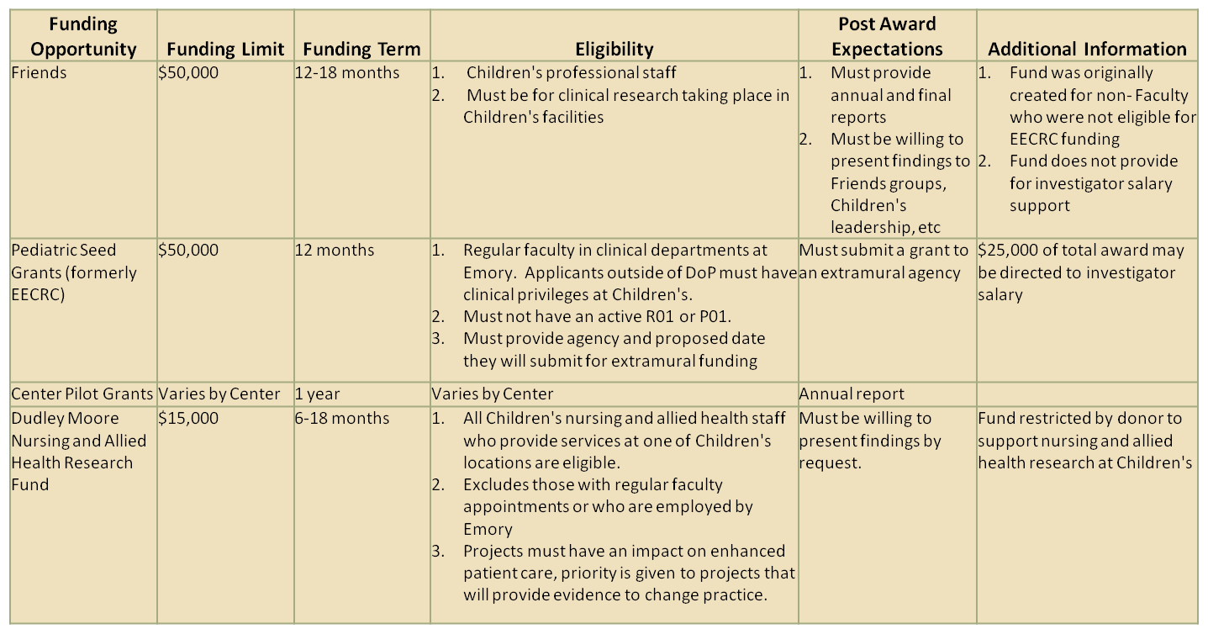
Funding Opportunities:
Research Update December 2013
Notes:
10

Slide 11
Additional Resources/Updates:
Research listserv: Contact barbara.kilbourne@choa.org to be added to this listserv used to disseminate all pediatric research related announcements including seminars, funding opportunities, such as BiRD (Bringing in the Research Dollars), and the Weekly PREP (Pediatric Research Events and Programs) | Website: www.pedsresearch.org This is the central resource for research seminar info, contacts, cores, calendars, forms
Health Sciences Research Building: 1760 Haygood Road Atlanta, GA 30322 190,000 ft²; 115,000 for pediatric research Dry and wet lab research For floor plans go to: http://pedsresearch.org/_files/HSRB_FloorPlans.pdf Go to: http://www.pedsresearch.org/about-us for more info
Research Update December 2013
Notes:
11

Slide 12

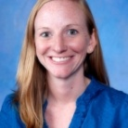
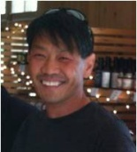
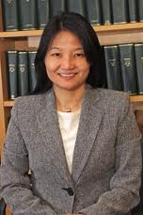
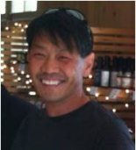
Research Recruitment Update:
NAME | PHOTO | CENTER | TITLE | START DATE | RECRUITED FROM | RESEARCH INTERESTS
Elizabeth “Beth” Stenger, MD |  | Aflac Cancer and Blood Disorders Center | Assistant Professor | August 2013 | Children’s Hospital of Pittsburgh, University of Pittsburgh | Enhanced IL-12 Production by mTOR-inhibited DC and Protection from GVHD
Brandon Aylward, PhD |  | Children’s Center for Neurosciences/ Children’s Center for Cardiovascular Biology | Assistant Professor | July 2013 | Cincinnati Children’s Hospital Medical Center | He received his doctoral degree in clinical child psychology with a minor in quantitative psychology from the University of Kansas and completed his predoctoral residency program at Cincinnati Children’s. His research interests encompass a broad range of health-related issues for children and adolescents within the context of pediatric psychology. To this end, his work has focused on three main areas: (1) predictors and correlates of children’s psychosocial, developmental and physical functioning in various chronic illness populations; (2) trends and correlates of adherence and self-management behaviors; and 3) use of advanced statistical methodology and innovative technology to examine predictors and outcomes for chronic health issues.
Baek Kim, PhD |  | Center for Drug Discovery | Professor, Director, Children’s Center for Drug Discovery | May 2013 | University of Rochester Medical Center School of Medicine and Dentistry | His 20 years of experience in biochemical and virological research, which has been fully supported by NIH, has been focused on the replication process and cell tropism of HIV/AIDS and influenza virus, Recently, Dr. Kim has recently initiated enzymological and mechanistic research on WNV and Dengue RNA polymerases, which will be incorporated into the drug discovery programs of the center.
Hyunmi Kim, MD, PhD |  | Children’s Center for Neurosciences | Pediatric Neurologist, Head of Children’s Epilepsy Program | April 2013 | University of Alabama in Birmingham | Pediatric neurology
Research Update December 2013
Notes:
12

Slide 13
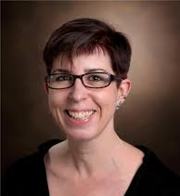
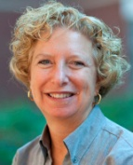
Research Recruitment Update (continued):
NAME | PHOTO | CENTER | TITLE | START DATE | RECRUITED FROM | RESEARCH INTERESTS
Anna M. Kenney, PhD |  | Aflac Cancer and Blood Disorders Center | Associate Professor | January 2013 | Vanderbilt University Medical Center, Department of Neurological Surgery | Her research addresses how signal transduction pathways interact to regulate gene expression and post-translational protein modifications that impact the neural precursor proliferation, differentiation, and transformation into brain tumor cells. This work focuses on the Sonic hedgehog signaling pathway due to its involvement in critical processes of brain development and tumorigenesis, especially pediatric and adult medullablastoma, and uses primary cell cultures, in vivo models, and biochemical/genetic approaches.
Joanna B. Goldberg, PhD |  | Center for Cystic Fibrosis Research | Professor | January 2013 | University of Virginia | The major focus of our laboratory is in the investigation of strategies used by bacteria to cause diseases in humans. We study various bacteria and their factors especially surface polysaccharides and other potential adhesions, and assess their effect on the virulence and physiology of the bacterium, as well as on host cells. Our general approach is to perform genomic analysis, construct, and characterize bacterial mutants, and monitor these for relevant phenotypic and genotypic characteristics and in in vivo and in vitro models of infection. The long-term goal of this work is to devise rational methods to the disrupt virulence and promote clearance of infecting bacteria.
Research Update December 2013

