Slide 1
CIRC Appointment
Scheduling

Slide 2
Request Form
Fill out this form according to the following instructions and submit accordingly

Slide 3
Request Form: Patient Information
For the patient information, please include all fields:
Patient Name
Date of Birth
Diagnosis
MRN
Account/HAR #

Slide 4
Request Form: Study Name/location
Always include the study name and location the study visit will be performed

Slide 5
Request Form: Parent/Guardian Information
For the parent/guardian information, please include these fields:
Parent/Guardian Name
Phone
Relationship to Patient
You DO NOT need to fill out the Insurance Information
Attaching the patient face sheet is encouraged.

Slide 6
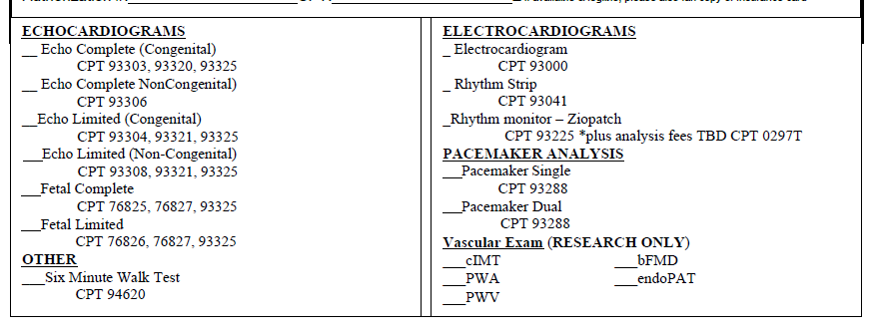
Request Form: Exams to be Done
In this section, check what exams need to be performed
Be sure that checked procedure matches budget obtained from CIRC

Slide 7
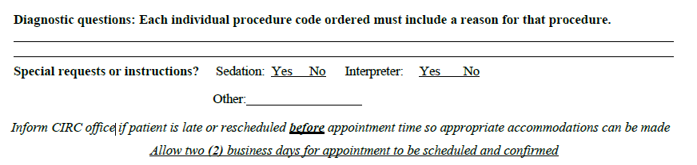
Request Form: Study Information
In this section, please include:
On the first lines, write the patient diagnosis (ex: Chronic Kidney Disease)
For diagnostic questions, include the short title of the study with the visit number (ex: XYZ123 Cycle 1 Day 1)
For special requests, answer the sedation and portability questions. You can also include any specific instructions (ex: Complete exam 2 hours after first dose)
For procedure completed, please include the date and time for the study (decided after talking to CIRC coordinators)

Slide 8
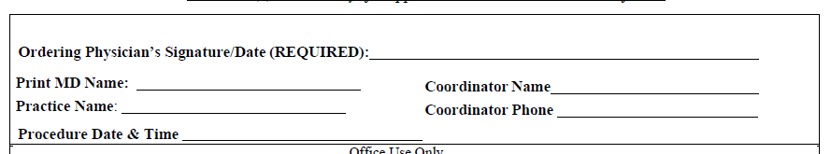
Request Form: Signature and Contact Information
In this section, please include:
Physician Wet Signature
Printed Name
Requested Procedure Date and Time
Office Contact – Coordinator/Nurse Information
Practice Name (ex: Aflac)
Phone Number

Slide 9
Sample Request Form

Slide 10
Request Form Submission
Once your form is completed
Orders have been placed in EPIC
Send request form to CIRC Coordinators at:
  Deanna.Hill@choa.org (5-5214)
  Guadalupe.Izaguirre@choa.org (5-0628)

Slide 11
Scheduling Request Tips
  Have multiple options ready that work for the patient
Appointments are scheduled on the hour from 8:00-11:00 AM and 1:00 – 3:00 PM, Monday-Friday
Investigator should put orders in prior to submitting appointment request.
    EG CARD IMAG RSCH CORE [211467]
    Orders should be submitted under “Future”, unless same day
    Orders should include study name
Submit form as early as possible (at least 48-72 hours)
Check EPIC within 48 hours of submitting form to check for the appointment. If one is not in there, contact the CIRC coordinators or schedulers for assistance

Slide 12
Information for Coordinators for Study Visit Days
Please stay with your patient in the waiting room until the sonographer comes out to get your patient. The sonographer may have questions pertaining to the study number, de-identification, etc.
Provide the sonographer with a contact number in case they need to reach you
If a CD or paperwork is required from the sonographer, those materials will be left in the research mailbox behind the sonographer’s office. For studies that require upload by a CIRC coordinator, please provide the coordinators with these materials from the mailbox if the sonographer hasn’t.

Slide 13
Contact Information
CIRC Coordinators
  Desk: 5-5214
  Email: Deanna.hill@choa.org
  Desk: 5-0628
  Email: Guadalupe.izaguerra@choa.org
CIRC Sonographers can be contact through Voalte
  EG Voalte phone: 43332
  SR Voalte: SR Echo cardiographer

Slide 14
Thank you!

Slide 15
Once you have completed this training, please follow the link below to send a confirmation email.
CIRC Training Confirmation

