Slide 1
Crowdsourcing strategies to hire the best and brightest to staff your research program
12/12/2022

Slide 2
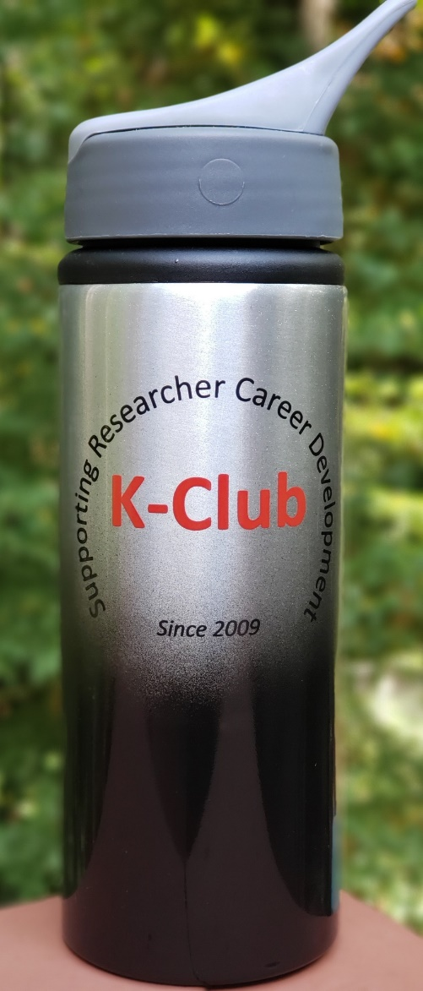
Survey Drawing

Slide 3
K-Club Special: Georgia CTSA KL2 Program
Salary support for 75% of their professional time (50% is allowed for trainees from surgery or surgical subspecialties) on clinical and translational research and research training.
KL2 technical budget of $25,000 per year for research-related expenses and tuition for the Master of Science in Clinical Research (MSCR) degree or Certificate Program in Translational Science (CPTS) programs.
A two-part KL2 Application Workshop was held on October 20 and 27th, 2022. These sessions were recorded and are now posted on the Georgia CTSA KL2 website, linked below
Deadline: February 01, 2023, 5 pm
https://georgiactsa.org/training/kl2.html

Slide 4
K-Club Special: The Emory Building Interdisciplinary Research Careers in Women's Health
BIRCWH connects junior faculty to senior faculty with shared research interests in advancing women's health research, improving sex/gender science, and promoting health and well being among women.
Each scholar accepted into the program must submit a mandatory Career Development NIH K Award (e.g. K23, K01, K08) or equivalent grant application by the end of their first 12 months of the BIRCWH funding.
Minimum 75% Full-time effort
Deadline: February 1, 2023
https://med.emory.edu/departments/medicine/divisions/infectious-diseases/studies-programs/bircwh/index.html

Slide 5
K-Club Special: Pediatric and Reproductive Environmental Health Scholars (PREHS) Southeastern Environmental Exposures and Disparities (SEED) Program -- K12
Provides junior clinical faculty from Emory School of Nursing and School of Medicine and Morehouse School of Medicine with comprehensive training in pediatric and reproductive environmental health research.
Faculty scholars will collaborate with local community partners and the Region 4 PEHSU — a region burdened by systemic racism and increasing climate change-related environmental threats that intensify health disparities.
Minimum 75% Full-time effort
Deadline: February 1, 2023
https://www.nursing.emory.edu/pages/prehs-seed-program

Slide 6
K-Club Special: Atlanta Network Training in KUH Scientific Research – TL1/U2C (ATLANTIS)
TL1 portion: Provides financial support for pre and post docs engaged in research relevant to nephrology, urology, and non-malignant hematology
U2C portion: Provides professional development training via an ATLANTIS Professional Development Core and collaborative and networking connections via an ATLANTIS Network Core
Minimum 75% research effort
Deadline: Applications are currently being accepted on a rolling basis, and will be reviewed on December 15, 2022, March 15, 2023, and June 15, 2023, subject to the availability of positions.
bit.ly/ATLANTISProgram

Slide 7
Today’s Presentation
Crowdsourcing strategies to hire the best and brightest to staff your research program
Discussion facilitated by Stacy Heilman, PhD,
Assoc Prof & Assoc Vice Chair for Research
Dept of Pediatrics & Children’s Healthcare of Atlanta
Notes:
Panelist introduction (including hiring philosophy)

Slide 8
Special Acknowledgement

Slide 9
Fast forward through some important stuff…
Defining the need and identifying salary source
Selecting the job title
Job title/description in the job description library
Minimum qualifications
Adding preferred qualifications and other language
Proposing virtual/hybrid/in person
Requesting position to be posted
These are all very important steps and
should not be glossed over!

Slide 10
Today’s discussion points
Recruitment marketing
Resume review
The interview process
The final candidate selection process
Making an offer

Slide 11
Recruitment Marketing
Notes:
Advertising open positions in an effective way to attract the best talent for the position. Recruitment marketing is the practice of using marketing strategies to attract, engage, recruit, and retain talent. Included in this are employer branding, digital marketing, social media, and candidate experience.
What is the baseline institutional advertisement strategy at Emory? - Cheryl
What other tricks/strategies have you used successfully to attract great candidates to your open positions? – other panelists
Social media
Linked In
Networking in person and via email
Flashy website
Importance of writing a special section of the job description and/or special email or social media post to highlight special attributes of your research program, Emory, and/or living in Atlanta
What steps to you take during the advertisement process to ensure candidate diversity? - all

Slide 12
Reviewing Resumes
Notes:
Cheryl, how does Emory HR select which resumes to put in the hiring manager’s queue?
Other panelists:
What is your strategy for reviewing resumes?
Do you ask others to help you?
What criteria do you use and do you use any formal evaluation metrics?
Are there any absolute non starters on resumes which would automatically make you reject a resume? (e.g. spelling errors)
What steps do you take during the resume screening process to ensure candidate diversity?

Slide 13
Two Step Interview Process
STEP 1: Initial Screen
STEP 2: Interview(s)

Slide 14
The Interview Process Step 1: Initial candidate screen
Formal interviews are time-consuming!
Phone screens/initial interviews can screen pool to determine whom to invite for additional interviews
Confirm minimum qualifications and “knock out” questions
Candidate motivations
Discuss compensation
Visa Question

Slide 15
The Interview Process Step 2: Full interview(s)
Steps for Step 2:
Deciding on who will be involved in the interview process
Setting interview format/structure
panels vs one-on-one
virtual vs in-person
Agree and document on core competencies including skillset and disposition
Establishing associated question bank
Creating an interviewer feedback form (qualitative and quantitative) to use in final hiring decision

Slide 16
Some question dos and don’ts

Slide 17
Talking About Money
“From a compensation perspective, what are you targeting?”
Response is in range/budget: “Okay, we are early in the process, but alignment is close, lets continue”.
Response is not in range/budget: “We may not have a match, that is higher than we will be able to pay for this job. Emory has a lot to offer outside of the salary, do you have flexibility?”
They may walk away
If they are hesitant, ask them to think about it and get back to you
Always remember to point them to the Benefits page on the website.
Slide content credit to Cheryl Coulthurst

Slide 18
Visa Discussion
Ask all candidates at the first point of process (1st contact). Never make assumptions based on name, school, address, etc.
It is not discrimination to consider US Citizens first, it is actually a requirement.
"Will you now or in the future require sponsorship to work in the US?"
If yes, confirm with HR Rep that the job code is sponsorship eligible before moving forward.
Confirm there is budget to support the visa transfer/sponsorship
Dispositioning - "Not Authorized to Work in the United States"
Slide content credit to Cheryl Coulthurst

Slide 19
Off limit topics
Do not gloss over tough parts of the job
Do not ask any questions unrelated to the job:
Age
Ancestry
Language
Marital Status
Religion
Social Clubs
Political Affiliations
Housing Status
Slide content credit to Cheryl Coulthurst

Slide 20
Is your question job related?
Slide content credit to Cheryl Coulthurst

Slide 21
STAR Behavioral Interview Method
S
Situation
Ask the candidate to recall a specific situation. Ensure their answer has specifics and is not a general response.
T
Task
Ensure you understand the task and challenges. Ask what was the goal, project scope or objective.
A
Action
Find out what they did and how they did it. Separate individual from team or generalities.
R
Results
What was the overall outcome and resolution? Would the candidate do anything different next time?
*Slide content credit to Cheryl Coulthurst

Slide 22
Walking us through an example
Notes:
Stacy will ask Melissa Murphy to share her approach

Slide 23
Selecting the final candidate
Role of reference checks
Using interviewing feedback
Other factors?
Decision maker(s)
Veto power considerations
Informing team/constituents

Slide 24
Making the offer
Compensation
Highlighting other benefits
Understanding who in your organization extends the offer
Handling negotiations

Slide 25
Questions and Final Thoughts

Slide 26
Appendix

Slide 27
Money FAQs
Q: When Should I talk to my candidate about money?​ | A: In the first interview! For both you and the candidate, it is essential that expectations on compensation are aligned early in the process. ​
Q: Are candidates required to tell us their salary when they apply? ​ | A: The Emory application has two fields in regard to salary: “​ What is your most recent salary?” and “What are your salary expectations?”. Neither require a response. There is pending legislation in congress that would prohibit the requirement of salary history on applications. Some municipalities and companies have already adopted this policy. H.R.7 - Paycheck Fairness Act is a bill related to the Fair Pay Act of 1963. ​
Q: How do I ask a candidate about their compensation? ​ | A: Generally, it is best for this discussion to be towards the end of the initial interview. ​ Example: “I’d like to understand your salary expectations for this role?”. Leaving the question open ended and allowing for some silence will encourage the candidate to open up.​
Q: Should I share the salary range of the job?​ | A: We recommend you avoid sharing the salary range. A candidate will naturally fixate on the top of the range. And inevitably will be disappointment come offer time. Better to set expectations low than high.​ Example: “HR does set job ranges and offers are determined by a number of factors including your education and experience. What range are you targeting?”​
Slide content credit to Cheryl Coulthurst
Notes:
Chelsee

Slide 28
Money FAQs (continued)
Q: How do I handle a disconnect in my budget and their expectations?​ | A: If their expectations is high: “Our target is lower than that, do you have flexibility?” “We may not have a match, our pricing for this role is less, we have great benefits and an ambitious objectives. Considering the larger picture would this opportunity still be of interest?” It is best to allow them to think further and come back to you then to convince them. Follow up with an email with a link to the benefits page and attached the Emory Perks pdf. ​
Q: What are the factors used to determine offer? ​ | A: Our goal is to be Fair and Equitable: ​ Candidates' education and applicable work experience​ Department budget​ Internal Equity of Department and across Campus by job code and grade​ Market conditions​ An individual’s last salary should not a determining factor in pricing a job or in determining an offer. We do realize it allows for some understanding of an early match of expectations to budget.​
Q: How do I handle my internal candidates?​ | A: Internal moves are mandated by policy, ensure the employee is aware of their current job grade and the job grade of the role they are interviewing for. Beyond that, please refer to your Recruiter and HR Rep​
Slide content credit to Cheryl Coulthurst

