Slide 1
Promoting Equity for Women in Academic Medicine:
An Evidence-Based Approach
Reshma Jagsi, MD, DPhil
Newman Family Professor
Deputy Chair, Department of Radiation Oncology
Director, Center for Bioethics and Social Sciences in Medicine
University of Michigan

Slide 2
Outline
Nature and causes of gender inequity in academic medicine
  Not simply due to a slow pipeline
  Rather, reflects the differential impact of
    Unconscious biases
    Gendered expectations of society
    Harassment
Evidence-based interventions

Slide 3
Women in the Medical Profession
Notes:
Data from Association of American Medical Colleges AAMC (TABLE 1: MEDICAL STUDENTS, SELECTED YEARS, 1965–2015), https://www.aamc.org/download/481178/data/2015table1.pdf
Data from Association of American Medical Colleges AAMC (TABLE B-1.2: TOTAL ENROLLMENT BY U.S. MEDICAL SCHOOL AND SEX, 2015-2016 THROUGH 2019-2020), https://www.aamc.org/system/files/2019-11/2019_FACTS_Table_B-1.2.pdf
Data from American Medical Association AMA (TABLE 6.5, PHYSICIANS BY AGE AND GENDER, 1975-2013, PHYSICIAN CHARACTERISTICS AND DISTRIBUTION IN THE US, 2015 EDITION)

Slide 4
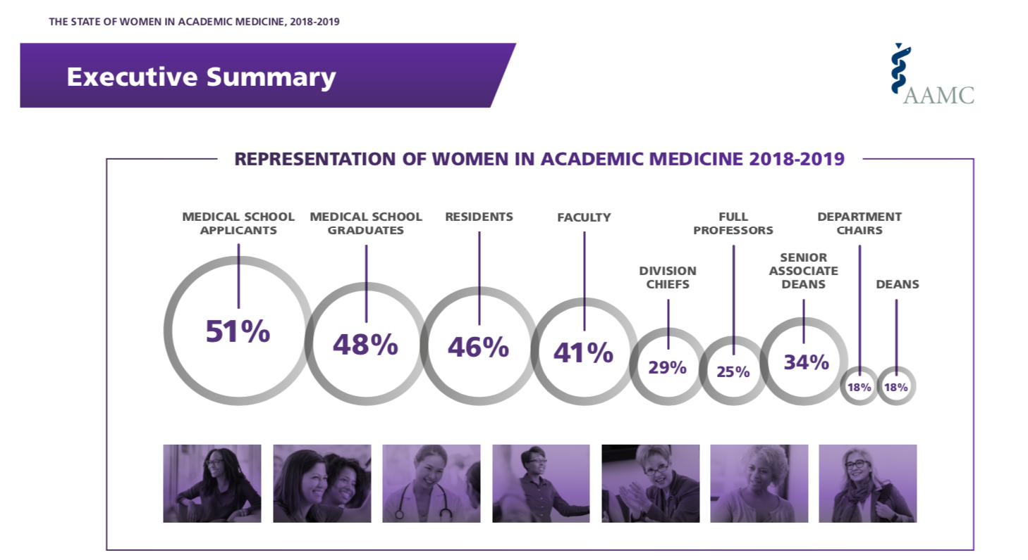
Women in Leadership

Slide 5
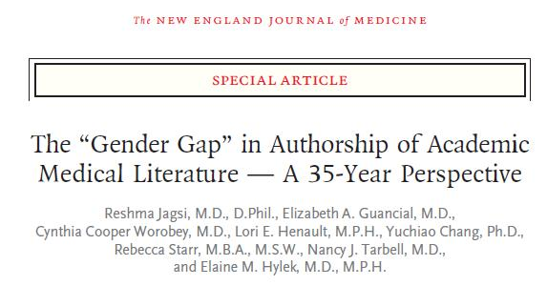
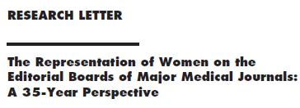


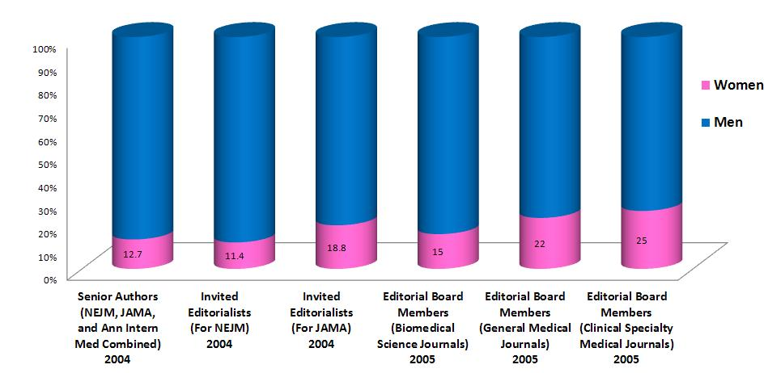

Slide 6
Should We Just Be Patient?
Pipeline hypothesis
Nonnemaker (N Engl J Med 2000;342:399-405)
  15 cohorts graduating medical school 1979-1993
  proportion of women who advanced to associate professor significantly lower than expected in all but 2 of the 15 cohorts
  even women who reached the rank of associate professor less likely to become full professor than male counterparts
  criticisms
Need for further research
  Richter et al. (N Engl J Med 2020; 383:2148-2157)

Slide 7
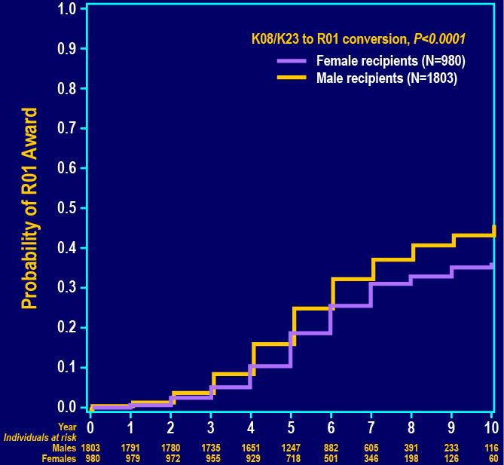
5-yr rate of R01 attainment: 19% among women and 25% among men
Gender (HR 0.8, p=0.002) independently significant predictor of R01 attainment on multivariable analysis controlling for K award type, year of award, funding institute, institution, and specialty

Slide 8
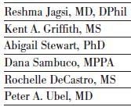


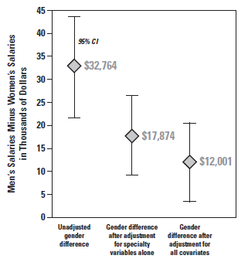
Compensation
800 MDs who were still working at academic institutions responded to our surveys of K awardees from 2000-2003
Significant gender difference in annual salary even after adjustment for numerous measures of success/productivity, specialization, and other factors
  Age
  Race
  Marital status
  Parental status
  Additional doctoral degree
  Academic rank
  Leadership positions
  Specialty
  Current institution type (public/private)
  Current institution region
  Current institution NIH funding rank group
  Whether changed institutions since K award
  K award type
  Years since K award
  K award funding institute
  Receipt of R01 or >$1 million in grants
  Publications
  Work hours
  Percent time in research

Slide 9
What Drives These Differences?
Specialty “choice”
  Women may be encouraged to occupy lower-paid specialties, specialties chosen by women may pay less partly because they are predominated by women or involve less valued “feminine” behaviors
Differences in productivity, hours, and “willingness” to change institutions
  Constraints of a gender-structured society
Differences in rank and leadership
  May reflect biased processes for determining rewards
But a substantial unexplained gender difference remained even after accounting for all of these factors and more

Slide 10
Gender Differences in
Values or Behavior?
Perhaps mothers are more likely to sacrifice pay for unobserved job characteristics such as flexibility and fathers wish to earn more to support their families
  Relatively homogeneous job type
  No interaction between gender and parental status; even women without children had lower pay than men
Perhaps women don’t ask

Slide 11
Differences in Employer Behavior towards Men and Women?
Statistical discrimination
  employers make inferences based on group characteristics (such as mean productivity level) rather than considering individual characteristics when setting salaries
The concept of the family wage

Slide 12
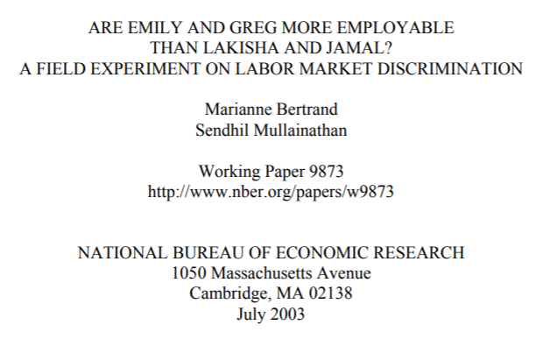
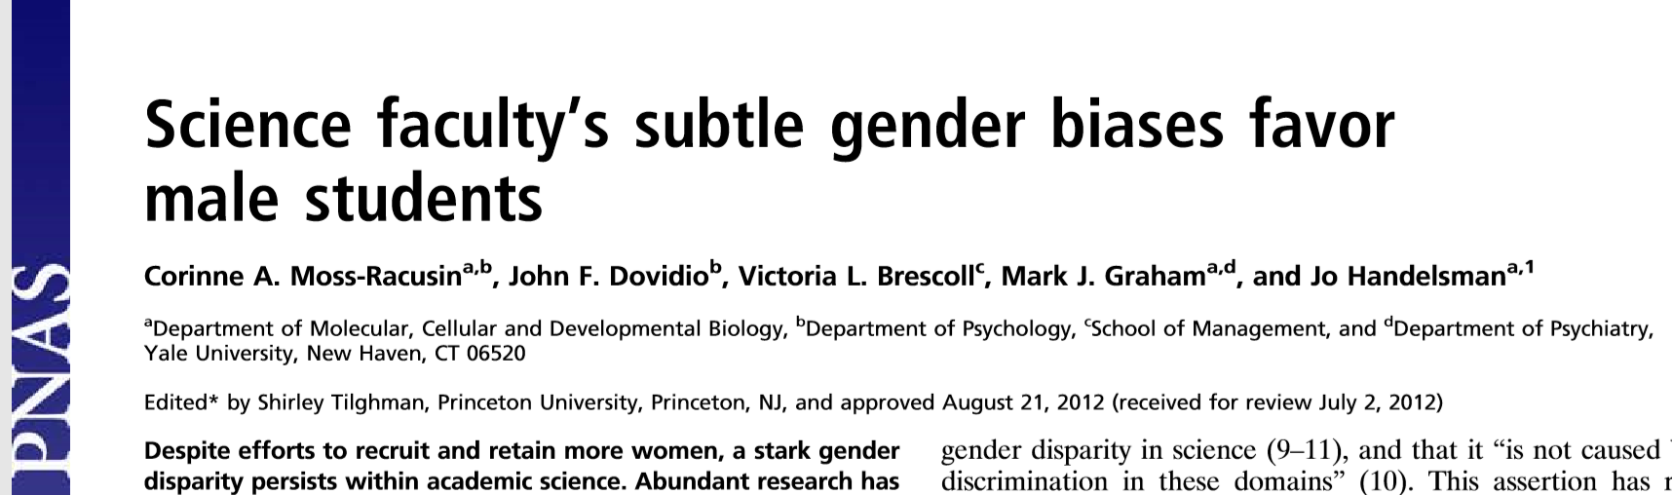
Unconscious Biases
Deeply ingrained notions held by all
NAS report
  “An impressive body of controlled experimental studies and examination of decision-making processes in real life show that, on the average, people are less likely to hire a woman than a man with identical qualifications, are less likely to ascribe credit to a woman than to a man for identical accomplishments, and, when information is scarce, will far more often give the benefit of the doubt to a man than a woman.”

Slide 13
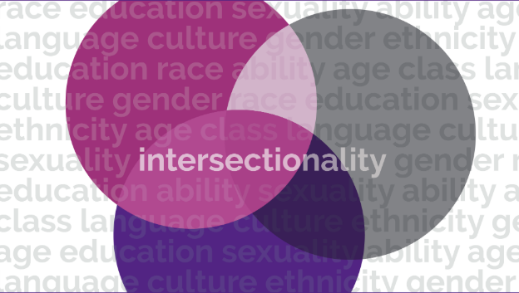
Multiple Identities
Jagsi R. How Deep the Bias? JAMA 2008.

Slide 14


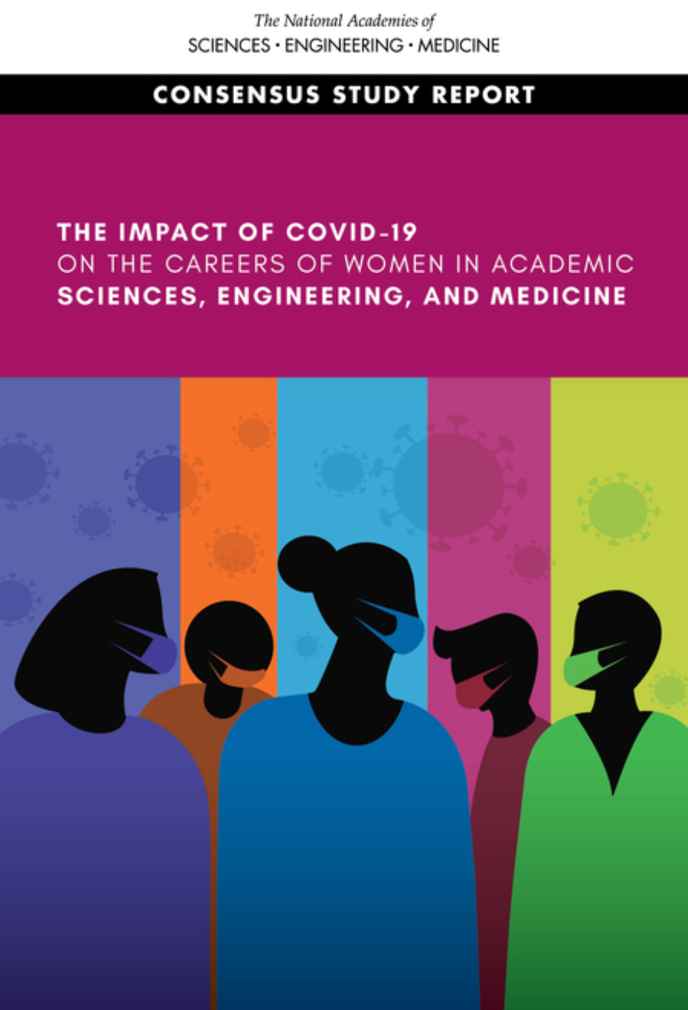
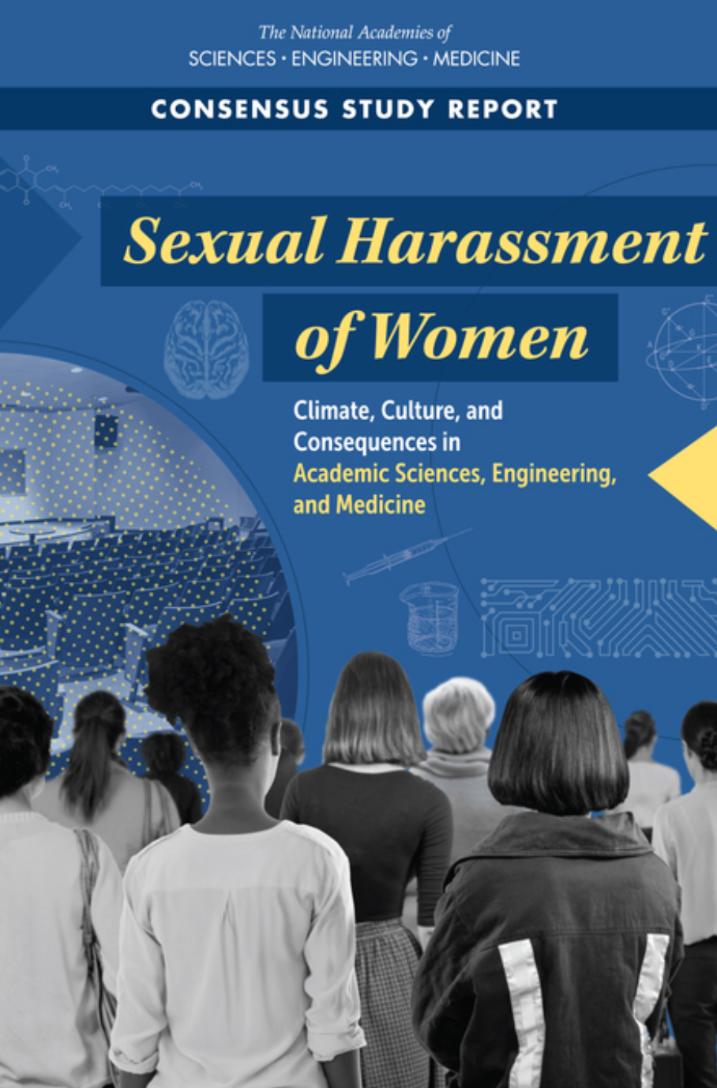
Key NASEM Reports
Notes:
Indeed, the objective data are so abundant that the National Academies have published multiple reports compiling the overwhelming evidence regarding gender inequity, the mechanisms that drive it, and interventions to target those mechanisms.

Slide 15
Not a Level Playing Field
Seemingly gender-neutral norms, practices, and policies can have a disparate negative impact upon women
  Examples
    Leave policies
      Jagsi, Weinstein, Tarbell, N Engl J Med 2007
      Magudia, Bick, Cohen, Ng, Weinstein, Mangurian, Jagsi, JAMA 2018
      Weinstein, Mangurian, Jagsi, N Engl J Med 2019
    Expectations regarding work hours
      Jagsi & Surender, Soc Sci Med 2002
    Tenure clocks & limits on grant eligibility
  Mechanisms
    forcing collision of biological & professional clocks
    magnifying the inequities of the traditional gendered division of labor

Slide 16
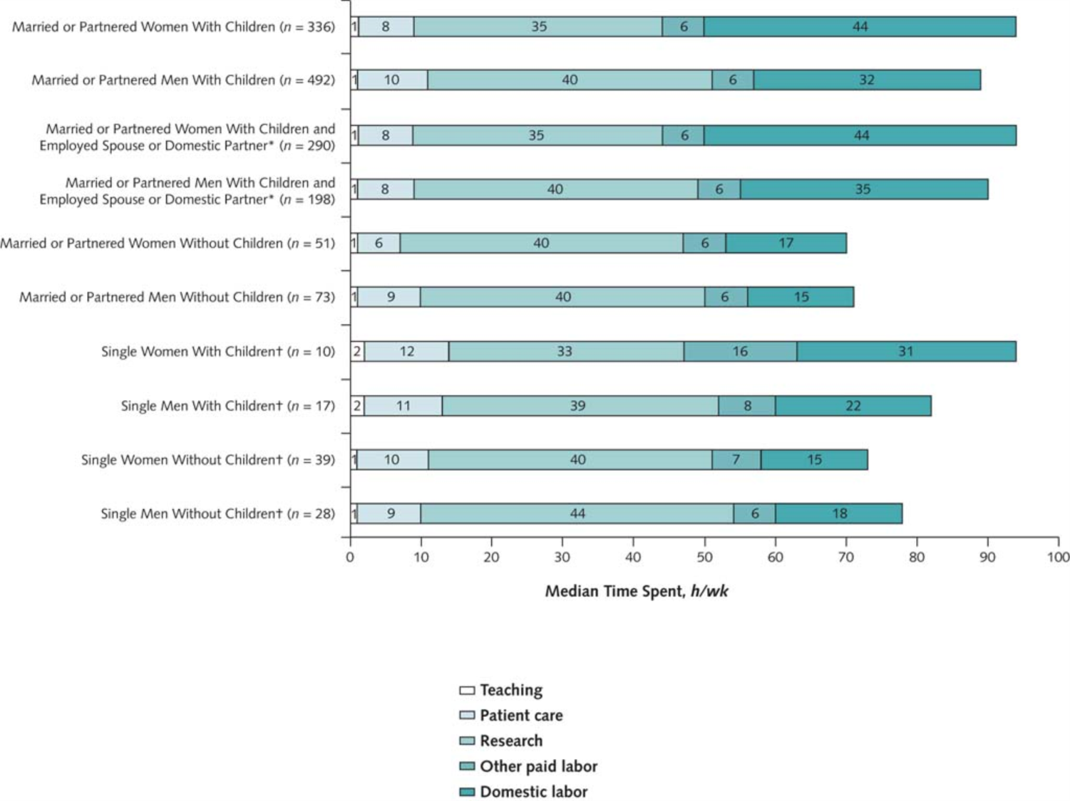
Gender Differences in Time Spent on Parenting and Domestic Responsibilities by High-Achieving Young Physician-Researchers
Ann Intern Med. 2014;160(5):344-353. doi:10.7326/M13-0974
Among married or partnered respondents with children, after adjustment for work hours, spousal employment, and other factors, women spent 8.5 more hours per week on domestic activities.
In the subgroup with spouses or domestic partners who were employed full-time, women were more likely to take time off during disruptions of usual child care arrangements than men (42.6% vs. 12.4%).
Jolly S, Griffith KA, DeCastro R, Stewart A, Ubel P, Jagsi R.

Slide 17




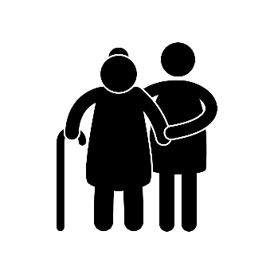
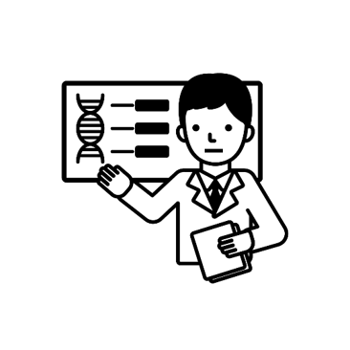
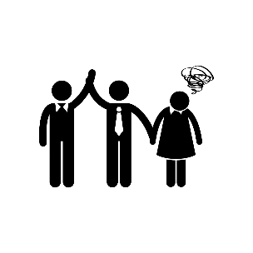

Work-Related Burnout in Physician-Scientists
Surveyed 816 Participants
Prevalence of Work-Related Burnout
Drivers of Gender Differences in Burnout
Implications
Time pressures
K Award
Women
41%
Perceptions of work climate
Need to improve work climate through
civility & respect
and mitigate
competing demands
Men
32%
NIH K grant recipients still in academia 5 to 8 years after award
Perumalswami, Griffith, Jones, Stewart, Ubel, Jagsi.
JAMA Internal Medicine, October 2019.

Slide 18
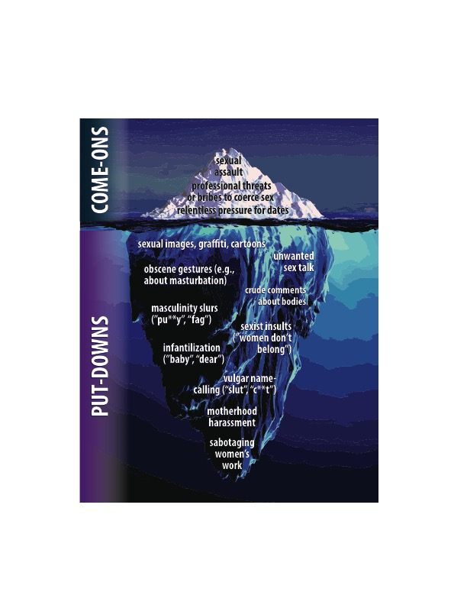
The Iceberg of Sexual Harassment
Image courtesy of and copyright held by Lilia Cortina

Slide 19
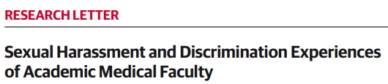
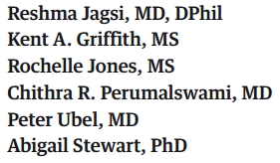
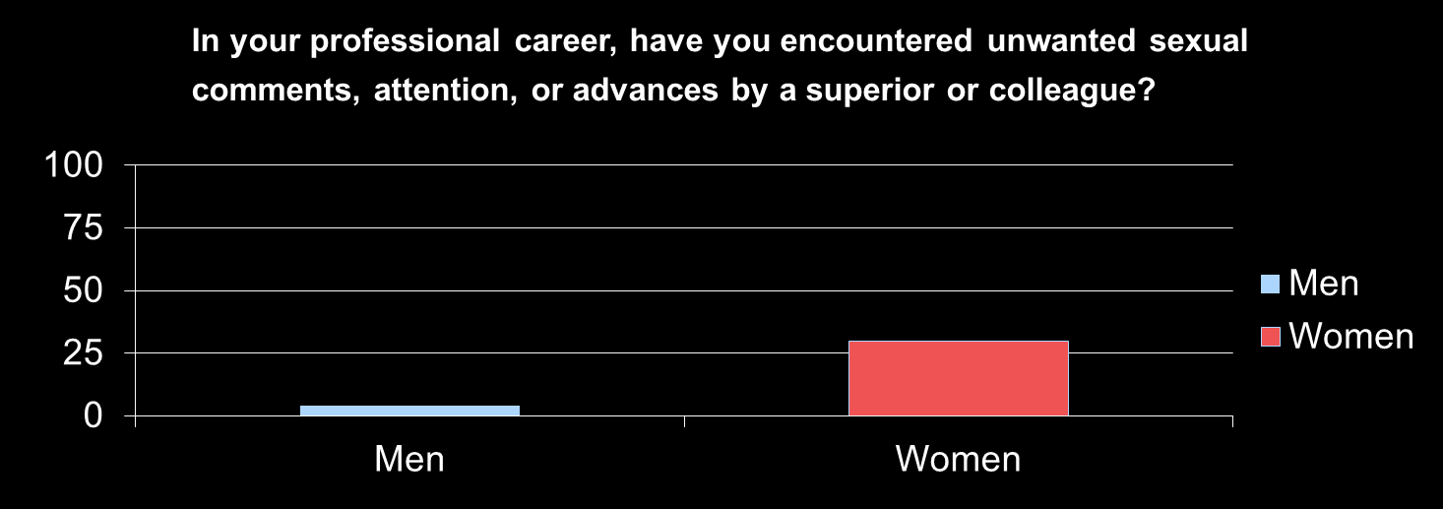
4%
30%
    59% perceived a negative effect on confidence in themselves as professionals
    47% reported that these experiences negatively affected their career advancement

Slide 20
Dr. Jagsi,
Your paper struck a particular chord with me... I brushed what happened under the rug; and in a residency program where the chair invites the male (and not female) residents & attendings over every week for poker, these things largely go unnoticed.
Over the past 4 years, I've wondered if something was pathologically wrong with me that I invited that kind of behavior (was it because I wasn't smart enough, was it because I was soft-spoken, was it because there was something so wrong with me that I couldn't even recognize it) and whether it would keep me from achieving anything of merit.
I read your article with a mixture of simultaneous dismay and relief - dismay because how could such successful women be subject to that kind of discrimination - relief because despite what they endured, they were successful...and if they have gone through similar things, then maybe I'm not defective.
I don't think I can ever talk about my experiences partially because of fear, partially because it seems ungrateful to do so...
I hope institutions pay attention. I hope people care. Your article helped me gain the closure that I didn't realize I needed.

Slide 21
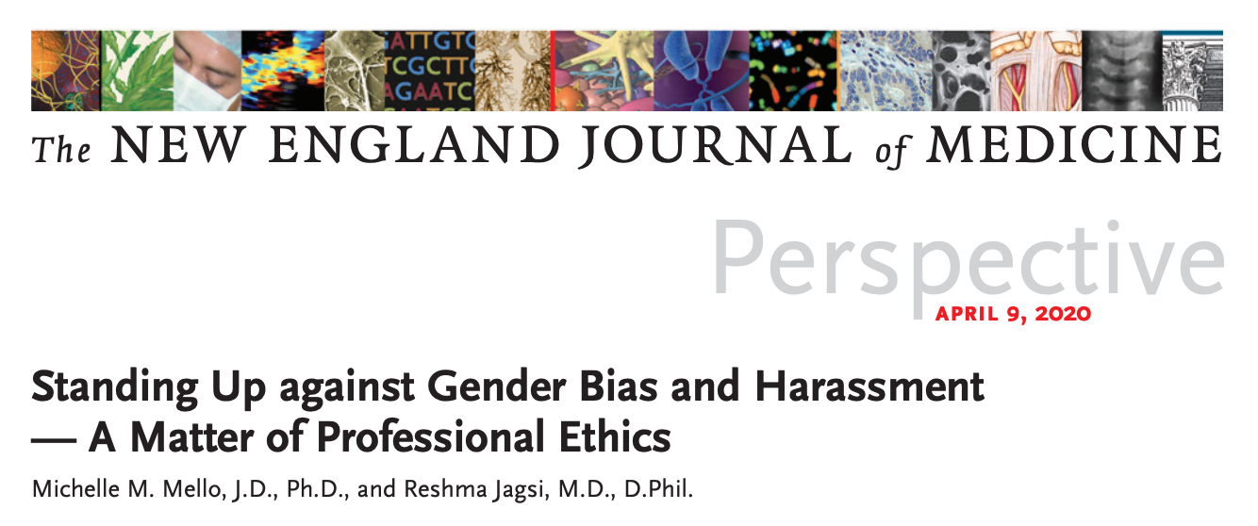
An Ethical Imperative to Act
Notes:
Both deontological and teleological arguments can be articulated about the need to promote gender equity
Codes of ethics should say more...

Slide 22

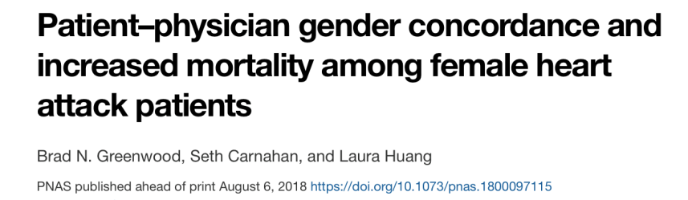
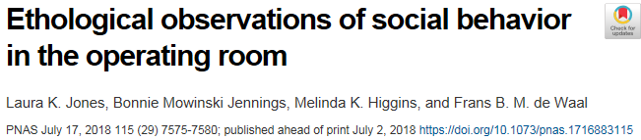
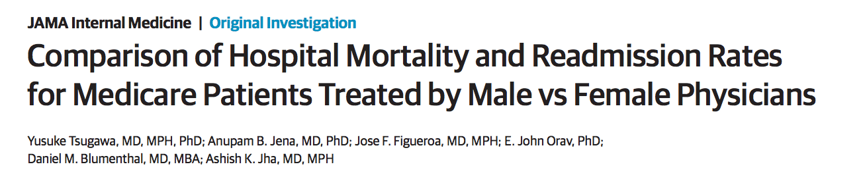
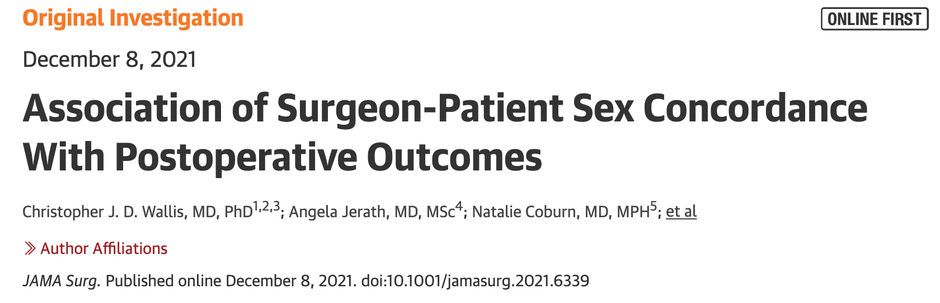
Teleological Arguments

Slide 23

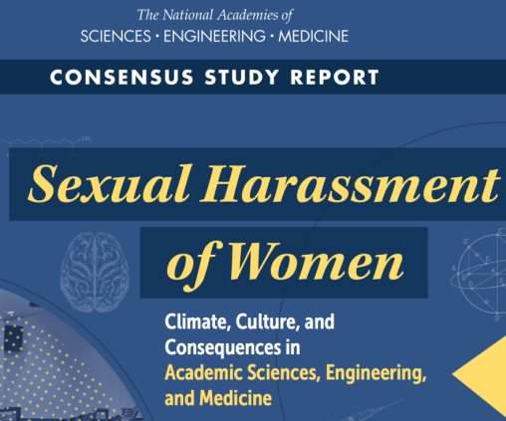
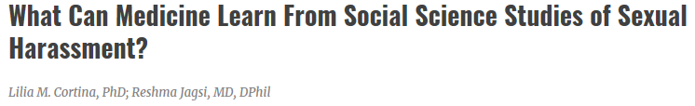
Interventions
To address strikingly high rates of harassment in medicine, must learn from evidence:
  Gather data
    Improve understanding (especially regarding women in under-represented or vulnerable groups)
    Inform interventions
    Demonstrate commitment
  Facilitate reporting and offer choices
  Clarify policies
    Lowest rates of sexual harassment in organizations that proactively develop, disseminate, and enforce sexual harassment policy (Gruber 1998)
  Address harassment by patients & families

Slide 24
Causal Mechanisms
Unconscious Bias
Gender Inequity
Sexual Harassment
Gendered Division of Domestic Labor
Notes:
In brief, we know from decades of social scientific research that gender inequity develops as a profound downstream consequence of persistent unconscious biases, sexual harassment, and the gendered division of domestic labor in our society. We also know that there is a vicious cycle: gender inequity itself creates an environment in which bias, harassment, and gendered expectations thrive. A lot of my own scholarly work has focused on how to measure these constructs.

Slide 25
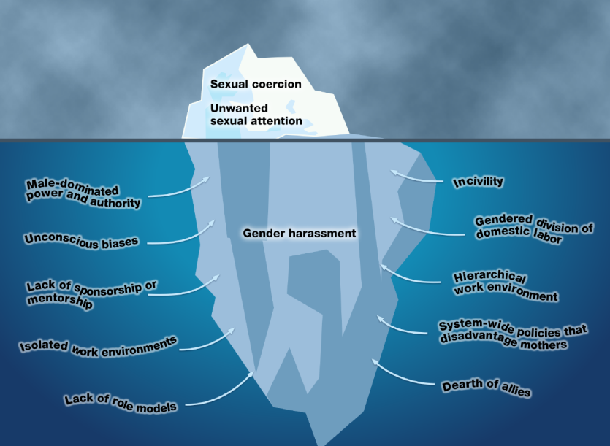
Why Does the Iceberg Form?
Beeler, Cortina, Jagsi. JCI 2019.

Slide 26

EQUITY is essential
  Change the structures that support harassment
    Employ more women
    Promote more women
    Integrate more women into every level of the organization
      Goal: “a ‘well-integrated, structurally egalitarian workplace,’ in which women and men equally share power and authority” (Schultz 2003 qtd in Cortina & Berdahl 2008)

Slide 27
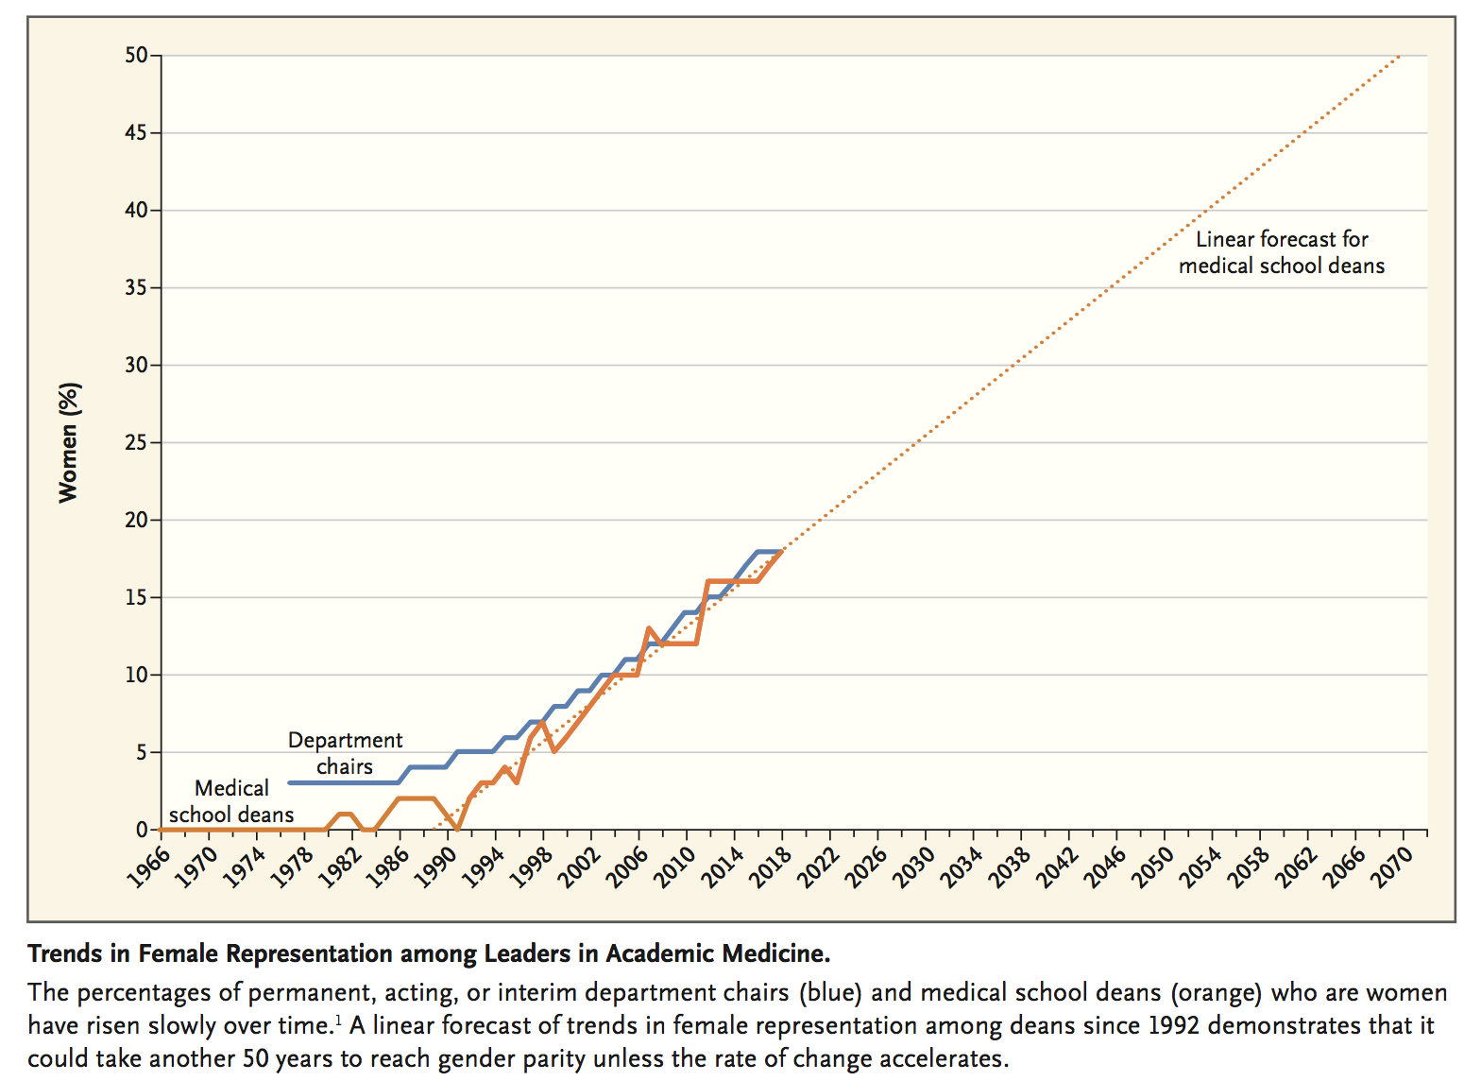
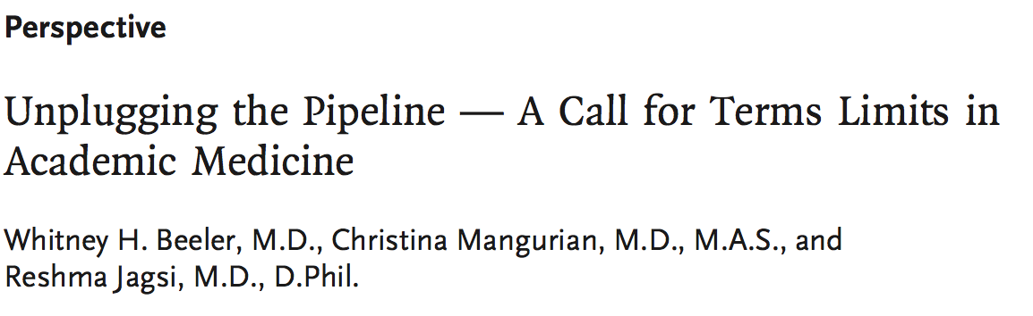

Slide 28
Don’t Fix the Women: Fix the Systems
Gender equity must be promoted through recognition and changes at the institutional level
  Mentorship and Sponsorship Programs
    Decastro R, Sambuco D, Ubel PA, Stewart A, Jagsi R. Mentor Networks in Academic Medicine: Moving Beyond a Dyadic Conception of Mentoring for Junior Faculty Researchers. Acad Med 2013.
    Patton E, Griffith K, Jones R, Stewart A, Ubel P, Jagsi R. Differences in Mentor-Mentee Sponsorship in Male vs Female Recipients of National Institutes of Health Grants. JAMA Intern Med 2017.
  Evidence-based implicit bias training
    Carnes M et al. The effect of an intervention to break the gender bias habit for faculty at one institution: a cluster randomized, controlled trial. Acad Med 2015.
  Cultural transformation
    Michigan ADVANCE, Hopkins Task Force
    Pati S et al. Tradition meets innovation: transforming academic medical culture at the University of Pennsylvania's Perelman School of Medicine. Acad Med 2013.
  Transparent and consistent criterion-based evaluation, promotion, compensation processes
    Gold, Roubinov, Jia, Griffith, Carethers, Mangurian, Jagsi. Gender Differences in Endowed Chairs in Medicine at Top Schools. JAMA Internal Medicine 2020.

Slide 29
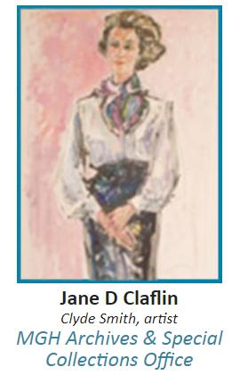
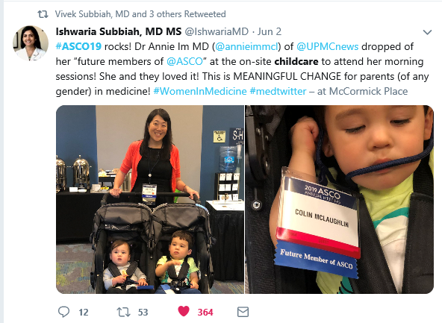
Promote Work-Life Integration
  Family/Medical Leave Policies
  Distinguished Scholar Awards
  On-Site Childcare and Facilitating Use of
  Funds to Support Dependent Care Expenses
  Time Banking
Jagsi R et al. A Targeted Intervention to Promote Women’s Careers in Academic Medicine. Arch Intern Med 2007.
Jagsi R et al. An Innovative Program to Support Gender Equity and Success in Academic Medicine: Early Experiences from the Doris Duke Charitable Foundation’s Fund to Retain Clinical Scientists. Ann Intern Med. 2018;169(2):128-130
Knoll M, Griffith K, Jones R, Jagsi R. Association of Gender and Parenthood With Conference Attendance Among Early Career Oncologists. JAMA Oncol 2019.
Ormseth C, Mangurian C, Jagsi R, et al. Implementation of Federal Dependent Care Policies for Physician-Scientists at Leading US Medical Schools. JAMA Int Med 2019.
Fassiotto MA, Maldonado YA. A time banking system to support workplace flexibility. http://wellmd.stanford.edu/content/dam/sm/wellmd/documents/Time-banking-system.pdf.

Slide 30



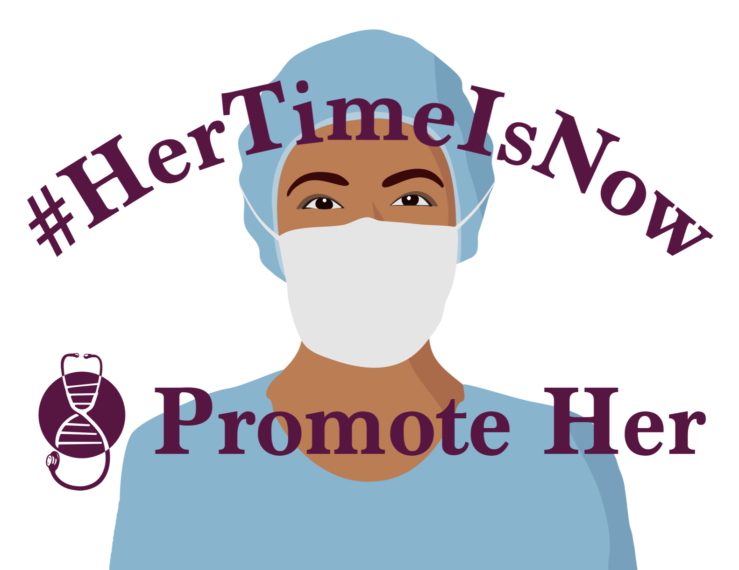

Social Media
Knoll M, Jagsi R. JAMA Oncology 2018.
@reshmajagsi

Slide 31
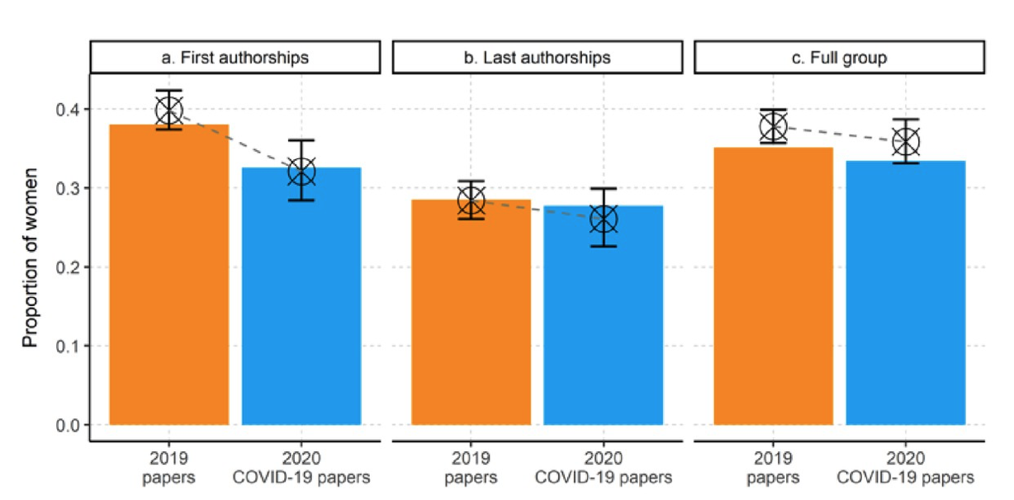
COVID Has Amplified Challenges
Andersen JP, Nielsen MW, Simone N, Lewiss R, Jagsi R.
ELife 2021.
Notes:
We have growing reason to pay attention to these issues since the outbreak of the pandemic. COVID has amplified many of the drivers of inequity; this study I recently led quantifies the early impact on female first authors.

Slide 32
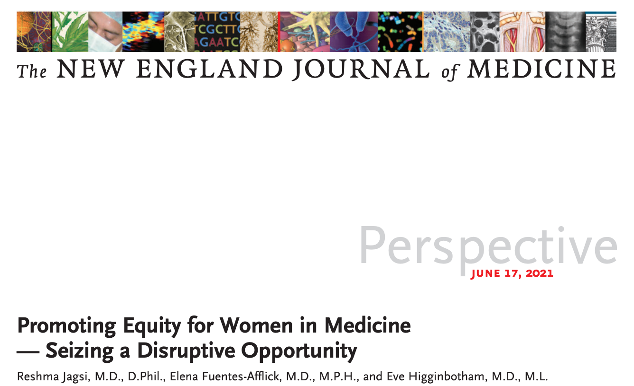

Slide 33
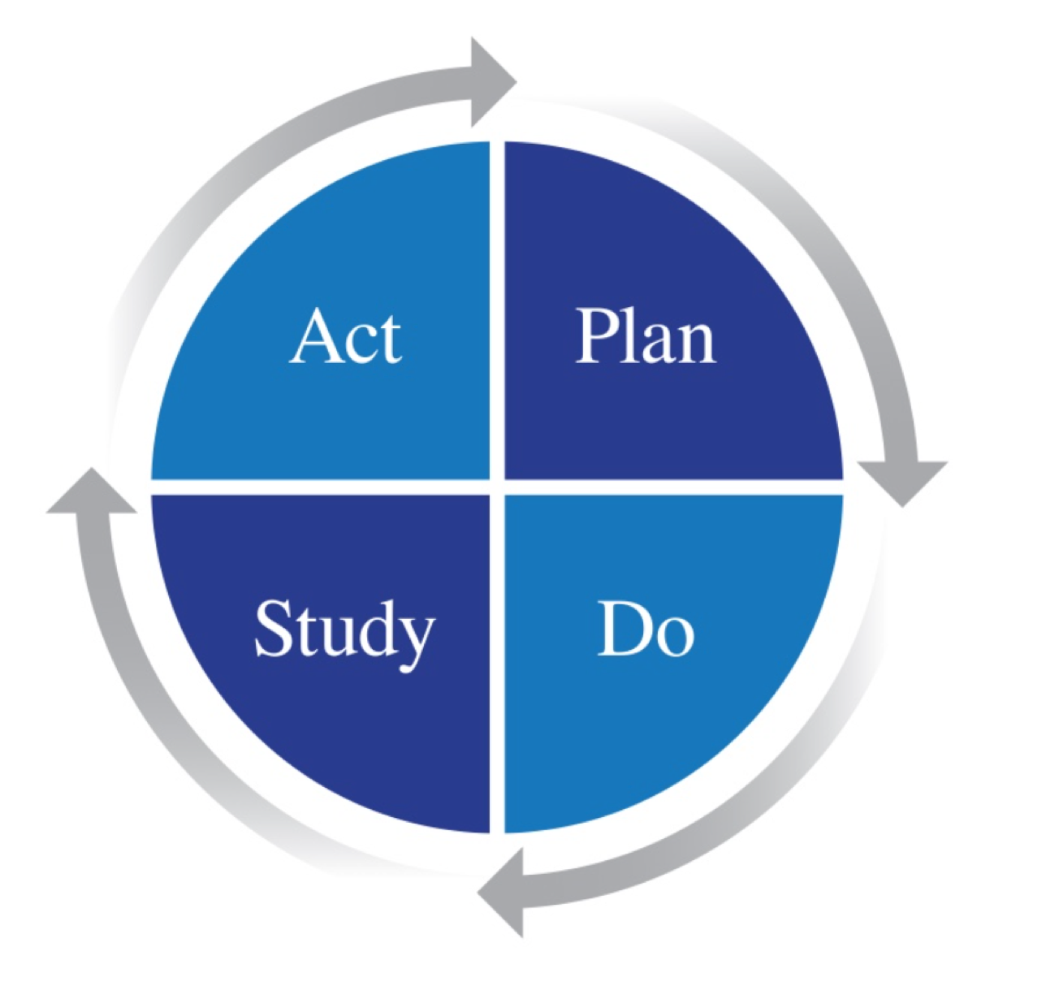
Conclusions
We inhabit a momentous time in history
Opportunity to move from awareness to action
Principles
  Dignity, safety, equity
    Fair equality of opportunity
    Equal pay for equal work
Health care quality improvement framework
  Structures, processes, outcomes

Slide 34

Acknowledgments
Collaborators
Nancy Tarbell, MD
Peter Ubel, MD
Abigail Stewart, PhD
Kent Griffith, MS
Rochelle DeCastro Jones, MS
Dana Sambuco, MA
Natalie Clark, MD
Emma Holliday, MD
Chithra Perumalswami, MD
Elizabeth Patton, MD
Shruti Jolly, MD
Pamela Douglas, MD
Kyoko Nomura, MD
Amy Motomura, BSE
Soumya Rangarajan, MPP
Deb Weinstein, MD
Rebecca Surender, DPhil
Elaine Hylek, MD
Mimi Knoll, MD
Christina Mangurian, MD
Dana Telem, MD
Nancy Spector, MD
Lauren Szczygiel,
Christina Chapman, MD
Michelle Mello, JD, PhD
Eve Kerr, MD
Isis Settles, PhD
Lilia Cortina, PhD
Emily Vargas, PhD
Mimi Knoll, MD
Resa Lewiss, MD
Nancy Spector, MD
Bridget Keenan, MD
Many others!
Funders
National Institutes of Health
Robert Wood Johnson Foundation
American Medical Association
The Doris Duke Charitable Foundation
University of Michigan IRWG & OVPR
Burroughs-Wellcome Fund/
Alliance for Academic Internal Medicine

