Slide 1
Research at Hughes Spalding
Updated Review and Approval Process January 2024

Slide 2
How will I navigate the review and approval process as a busy clinician investigator?
Resource – Clinical Research Managers
Marco Benoit
Bobby Uddo (AFLAC- Hematology)
Key Responsibilities:
Pre-award:
Meet with all investigator to understand proposed project
Facilitate the review process and completion of required forms
Gain approvals from appropriate departmental leaders
Present project for approval to administrative leadership
Assist in the achievement of all institutional approvals (IRB, GRADY ROC)
Post Award:
Facilitate “Round Table” meeting to include participating clinical leaders, investigators, coordinators prior to enrollment
Assist to provide project specific education to the clinical areas
Ongoing communication with investigators and clinical areas

Slide 3
Approval Process
Research at Hughes Spalding must have review and approval at each level.
Manager Approval
Janice Price-Law: Practice Manager (PCC)
Porscha Watts: Practice Manager (Specialty Clinics)
Kelly Thrift: Manager, Clinical Operations (All Clinics)
Heather Kersh: Manager, Clinical Operations (ED)
Director Approval
Joron Murry: Director, Physician Services
Shari Baker: Director, Patient Care Services
Stephanie Meisner: Director, Clinical Research
Stacey Brown: Director, Clinical Research (AFLAC)
Executive Approval
Darilyn Brown: VP Operations HS
Chevon Brooks, MD: Campus Medical Director

Slide 4
Approval Process
Ancillary Department Approval (As needed)
Research Pharmacy: Jane Chen, PharmD
Lab
Respiratory: Crista Jensen
Radiology: Fred Shambry
Facilities: Bill Auten

Slide 5
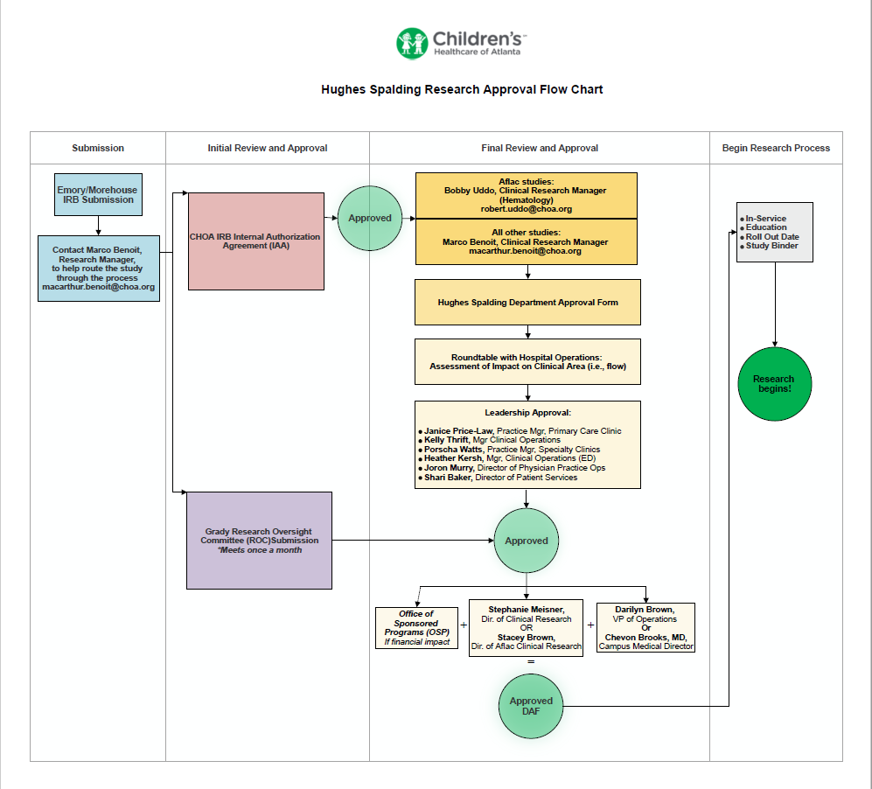

Slide 6
Contact Information
Name/Title | Phone/Email
Marco Benoit- Manager, Clinical Research | 404-785-2269 Macarthur.benoit@choa.org
Bobby Uddo – Manager, Clinical Research (AFLAC) | 404-785-1469 Robert.Uddo@choa.org
Stephanie Meisner- Director, Clinical Research | 404-785-6453 Stephanie.meisner@choa.org
Stacey Brown – Director, Clinical Research (AFLAC) | 404-785-4102 Stacey.Brown@choa.org
Amanda Simpson Manager, Office of Research Administration | 404-785-5172 Amanda.Simpson@choa.org

