Slide 1
Best practices in forming and fostering strong mentoring relationships
1/23/2023

Slide 2
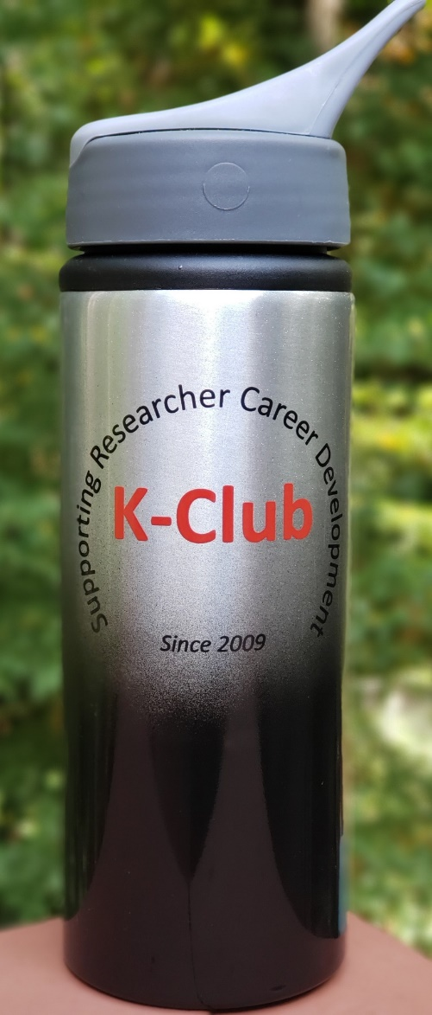
Survey Drawing

Slide 3
K-Club Special: NIAID Physician-Scientist Pathway to Independence Award (K99/R00 Independent Clinical Trial Not Allowed)
This program is designed to facilitate a timely transition of outstanding physician-scientists from mentored, research positions to independent, tenure-track or equivalent faculty positions, and to provide independent NIAID research support during the transition.
Applicants must have no more than 4 years of postdoctoral research experience at the time of the initial or the subsequent resubmission or revision application.
This program is intended for individuals who require at least 12 months and up to 24 months of mentored research training and career development (K99 phase) before transitioning to the R00 award phase of the program for up to 24 months.
Non-AIDS first deadline: Feb 12, 2023
AIDS first deadline: May 7, 2023
https://grants.nih.gov/grants/guide/pa-files/PAR-23-071.html

Slide 4
K-Club Special: Thrasher Research Fund Early Career Award
Physicians who are in a residency/fellowship training program, or who completed that program no more than one year before the date of submission of the Concept Paper or Post-doctoral researchers who received the doctoral level degree no more than three years prior to the date of submission of the Concept Paper are eligible.
All applicants must have a mentor. A mentor may have only one Thrasher Research Fund Early Career Awardee at a time.
All applications are expected to have a novel, scientifically sound, hypothesis-driven approach. Projects should be feasibly accomplished between 1-2 years.
Up to $25k in Direct Costs, up to $12,500 of which may be used for salary
Concept Paper Submission Deadline: March 14, 2023 2pm EST
https://www.thrasherresearch.org/early-career-award?lang=eng

Slide 5
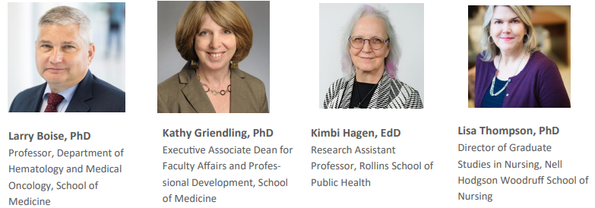
Panelists

Slide 6
Mentorship
A dynamic, reciprocal relationship in a work environment between an advanced career incumbent (mentor) and a beginner (protégé) aimed at promoting the development of both.
Healy and Welchert, Educ Res 1990;19:17-21.

Slide 7
Advantages of Mentoring
Advantages for the mentee:
Career advancement
Salary/job negotiations
Organizational/professional identification
Advantages for the mentor:
Career enhancement
“Passing the torch to a new generation”
Learning from mentee – new technologies, new developments, new ways to communicate and interact

Slide 8
Panel Discussion
What else do you consider to be rewards of mentorship mentor?
What can mentees do to magnify these rewards?
Can you share any examples of highly rewarding mentor/mentee relationships you’ve witnessed or been a part of?

Slide 9
Areas of Mentorship
Research (related to field, topic, technique, etc)
Career
Clinical
Work/life balance
What else?

Slide 10
How to meet prospective mentors
Notes:
Go to the Meet and Greet
Check out Peds Research.org profiles
Join the pedsresearch listserv and attend seminars
Attend Networking events (1-12-2023)
Literature search
Ask your resident colleagues
NIH Reporter Search

Slide 11
How to meet prospective mentors
Google searches: Academic websites, LinkedIn, Twitter feed
Join the listservs and attend seminars
Attend Networking events Literature search
NIH Reporter Search
Ask your peers and near peers

Slide 12
How to approach prospective mentors
Notes:
Go to the Meet and Greet
Check out Peds Research.org profiles
Join the pedsresearch listserv and attend seminars
Attend Networking events (1-12-2023)
Literature search
Ask your resident colleagues
NIH Reporter Search

Slide 13
How to approach prospective mentors
Ask for a mutual colleague for an introduction
Request an informational interview
Send an email demonstrating your understanding of their research (e.g. mention a recent publication)
Articulate your mentoring needs and values and ask for mentoring suggestions
Always follow up

Slide 14
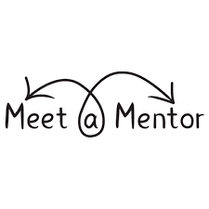
Panel Discussion
How do prospective mentees generally find you?
What approach are you most receptive to?
What do you think are the dos or don’ts when contacting prospective mentors?
Do you have any real life examples to share of best practices or approaches to avoid?

Slide 15
Piecing together a winning mentor team
Question:
How many mentors should you have?
Answer: As many as it takes!
Notes:
Mentees benefit from multiple mentors to gain exposure to a variety of styles, opinions, and experiences.

Slide 16
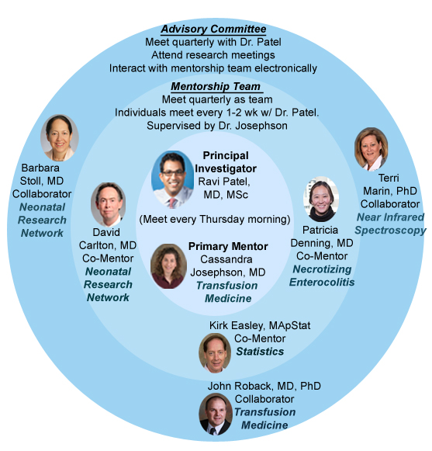

Slide 17
NIH Guidance on Mentor Team Strategy for K grants
Characteristics that need to be satisfied within the mentor team to show that the mentor plan is believable, reasonable and is set up for success.
Funding/Stability
Time considerations
Aligned research interests
Strong Biosketch
Demonstrated commitment to mentoring and career development
Notes:
Funding/Stability - Mentor's funding must reflect staying power within research. A very good rule of thumb is that mentors must serve as PIs on RO1s (or equivalent – e.g., U10s or U15s or project on a P01). K grants do not count. Is the mentor's active/pending support for the proposed research project appropriate and adequate to support the candidate's proposed plan? Is it highly likely that the mentor will remain a strong and funded researcher during the 5 year span of the candidates proposed research plan? If the mentor is a busy person (RO1s, PPGs, etc then co-mentors are strongly recommended).
Time considerations - Is the mentor available to meet? Does s/he have enough interest and bandwidth to dedicate to your development? Does the mentor commit time to meet when needed? The meetings should be scheduled and not as needed. However when there are new issues that arise, the mentor should have an open-door policy and be willing to meet. Reviewers expect that face-to-face meetings will be held for about 1 hour every week. If the study involves basic or translational science, then the applicant must attend and participate in weekly laboratory meetings. Is the mentor sufficiently committed to the mentee’s career development? Will the mentor prioritize the candidate and dedicate significant effort toward the K proposal preparation and other related projects, and to address and work through issues as they arise?
Organization of interactions – The proposal must illustrate the value and quality of the mentor's proposed role in providing guidance and advice to the candidate
Evaluation plan - Mentor must show adequate plans for monitoring and evaluating the career development awardee’s progress toward independence
Aligned research interests - Mentor's research expertise should be relevant to the candidate's. This does not, however, mean that the mentor has to be in the same field. Sometimes it looks bad when the mentor’s experience is TOO relevant. In this case, the reviewers question whether the mentor is the one who generates the ideas and does the work (and is simply is inserting a mentees name on the grant to support their salary). One example of a good mentor/mentee matching is if an infectious disease specialist might become interested in mechanisms of pseudomonas infections in CF patients. In that case, the mentor could be a CF expert (with experience in basic science relevant to pseudomonas). Within the mentor’s letter s/he might state that the mentee can take all the project deliverables with them when they leave to eliminate any guesswork related to ownership of the project. This will show the study is complimentary and not competitive.
Strong biosketch - Must show the mentor’s personal success in scholarship, whether measured by grants, papers, new curricula or educational products, and institutional, regional or national reputation. The mentor should have a strong publication history with lots of senior (last) author publications. Mentors with primarily first-authored papers might be viewed as too junior. Mentor/mentee co-authored publications are a benefit.
Commitment to mentoring and career development - Success of former mentees showing evidence from previous mentees. A table including the following fields for each trainee should be within the mentor's letter:
Trainee name
Training period
Institution/degree
Year
Level
Title of research project
Present position

Slide 18
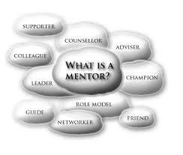
What makes a good research mentor?
Practical aspects to consider for mentorship in this phase of your career
Demonstrated track record in scientific writing (peer reviewed publication record)
Demonstrated track record in grant writing (PI on R01 funded grants as the gold standard)
Strong track record in research mentorship ideally of people at your same career stage
Available time to dedicate to you!
Notes:
From Ravi’s perspective

Slide 19
What makes a good research mentor?
Other aspects to consider for mentorship in this phase of your career
Career stage and scientific background
Understanding of time limitations (e.g. clinical obligations)
Help in setting realistic research aims and expectations
Help with setting realistic career goals and ability to develop a feasible plan toward those goals
Willingness to help you expand your professional network
Clarity around what research they own versus what research you own
Notes:
From Ravi’s perspective

Slide 20
Panel Discussion
Are you a part of a mentor team and if so, what types of interactions/arrangements do you find helpful?
What aspects do you think mentees should be most concerned about when selecting a mentor/mentor team?
What advice do you have for mentees regarding selecting a mentor versus a mentor team?

Slide 21
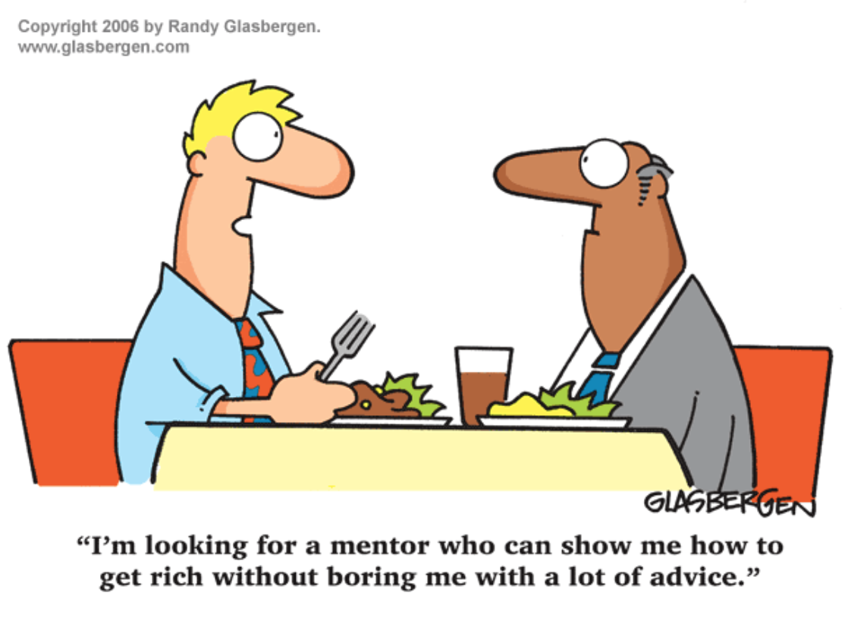
Good Versus Great Match
Good match
Research project
Skills
Experience

Slide 22
Good Versus Great Match
Great match
Research project
Skills
Experience
Personality
Work style
Motivation
Goals
Challenges

Slide 23
Panel Discussion
Do you have any examples of how personality/work styles can factor into good/poor mentor matches?
How can mentors and mentees assess these types of qualities before making a commitment?

Slide 24
What makes an amazing mentee?

Slide 25
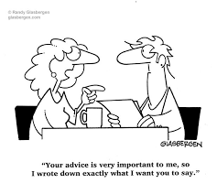
Mentee best practices
Being respectful of the mentor’s time and privacy
Following up and checking in
Good organization/making optimal use of your time together
Notes:
From the mentor’s perspective

Slide 26
Making it work
Mentee will ideally drive the meeting scheduling process
Setting expectations early and revisit often
Agree on meeting frequency and commit to being prepared (and define what “being prepared” means to each of you!)
Set goals, milestones and establish a realistic timeline
Consider establishing a formal mentoring agreement
Notes:
How you make it work from a functional perspective
Regular meetings with a set agenda?
Set deliverables with named deadlines?
Do you have a written or assumed “contract”? –
https://cdn.ymaws.com/www.gwis.org/resource/resmgr/files/mentor_mentee_agreement_-_ex.pdf

Slide 27
Mentoring Agreement Components
Objectives
Relationship structure such as meeting frequency and relationship duration
Key responsibilities of each party
Needs of each party (e.g. mentor’s availability outside of meetings, preferred communication modes for each)
Mutual expectations and goals (e.g. the mentor will review writing; the mentee will earn first authorship position if x, y, z conditions are met)
Concrete measures of progress and success (the mentee will present an abstract at X meeting on Y date)
Confidentiality agreement and contingency planning
This list is not exhaustive

Slide 28
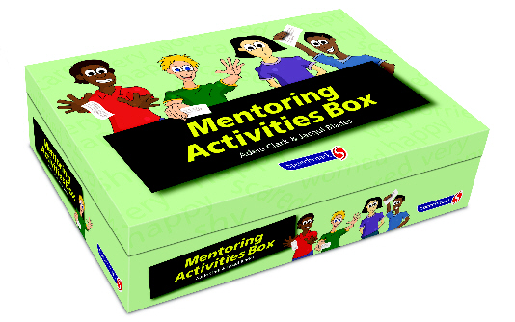
Regular Topics of Discussion
Planned experiments
Data interpretation
Planned abstracts, publications, grant applications
Feedback on abstracts, publications, grant applications
And also
Career Decisions
Job Search
Research Productivity
Managing multiple priorities
Conflict resolution
Reducing Stress
Work life balance
Responsible Conduct in Research
Ethical conduct of research

Slide 29
Panel Discussion
Do you use a mentoring contract?
How do you regularly communicate?
What are your expectations of your mentees?
Can you share examples of the approaches you think work well and others that maybe don’t?

Slide 30
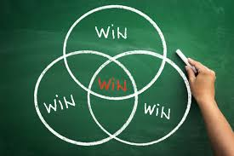
Making it a Win-Win

Slide 31
Panel Discussion
What are examples of what mentees can do for their mentors?
Do you have any examples of a time when a mentee provided value to you that you didn’t expect?

Slide 32
Challenges in the Relationship
Notes:
Differentiating research scope
Differing expectations
Disagreements on research direction or interpretation
Appropriate timing to publish and/or apply for R funding
Dissatisfaction may occur from a mismatch of goals, commitment, or expectations; from a reluctance of the mentee to own and pursue his or her own development; or from a mentee’s reluctance to ask for personal help.^{5,13} There can be power issues (over ownership of authorship or resources), generational tensions (over differences in work schedule expectations), or personality clashes (over differences in communication or work style).
Common mentor complaints are that the mentee did not follow through, the mentee did not use the mentor’s time effectively, or there was a poor fit with work style and/or personality.¹⁹

Slide 33
Potential pitfalls of mentoring relationships
Potential pitfalls for the mentee:
Overdependence on the mentor
Micro-management from the mentor
Negative halo from mentor who fails
Lack of follow through
Misalignment of expectations
Potential pitfalls for the mentor:
Mentee dependence on mentor
Time and energy commitment required
Negative halo from mentee who fails
Lack of experience in mentoring
Misalignment of expectations

Slide 34
Mentoring challenges
Dysfunctional mentoring: When the relationship does not work for one or more parties.
Power issues (over things like resources or authorship)
Interests of the parties change
Differences in judgment between parties
Intrusion/over-involvement in another’s personal problems
Triangulation problem with others (mentor/mentee/supervisor)
Destructive tone of relationship (e.g., envy/jealousy; dependency/suffocation; support/exploitation)

Slide 35
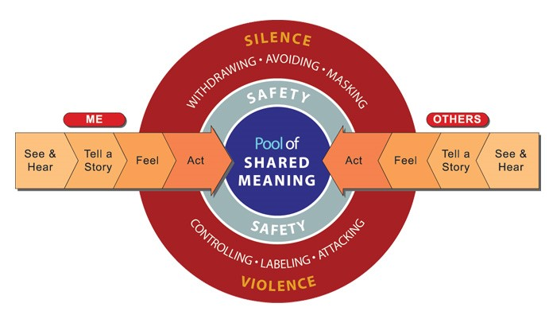
Remedying Mentoring Challenges
Arbitration (co-mentor or other colleague)
Refer back to mentoring agreement
Apply the principles of Crucial Conversations

Slide 36
Panel Discussion
Can you share examples where these approaches were used successfully?
What mentoring challenges do you think can be easily avoided and how?
Are there people/resources mentees can rely on to address mentoring challenges?

Slide 37
Characteristics Unsuccessful versus Unsuccessful Mentoring
Unsuccessful
Poor communication
Lack of commitment
Personality differences
Perceived (or real) competition
Conflicts of interest
Mentor’s lack of experience
Successful
Reciprocity
Mutual respect
Clear expectations
Personal connection
Shared values
Strauss et al, 2013

Slide 38
Evolving relationships

Slide 39
Phases of Mentor Relationship
PHASE | TIME PERIOD
Initiation | 6-12 months
Cultivation | 2-5 years
Separation | 6 months to 2 years
Redefinition | Indefinite
Kram, 1983

Slide 40
References
Zerzan JT, Hess R, Schur E, Phillips RS, Rigotti N. Making the most of mentors: a guide for mentees. Acad Med. 2009 Jan;84(1):140-4. doi: 10.1097/ACM.0b013e3181906e8f. PMID: 19116494. https://pubmed.ncbi.nlm.nih.gov/19116494/
Straus SE, Johnson MO, Marquez C, Feldman MD. Characteristics of successful and failed mentoring relationships: a qualitative study across two academic health centers. Acad Med. 2013 Jan;88(1):82-9. doi: 10.1097/ACM.0b013e31827647a0. PMID: 23165266; PMCID: PMC3665769. https://pubmed.ncbi.nlm.nih.gov/23165266/
Healy, C. C., & Welchert, A. J. (1990). Mentoring Relations: A Definition to Advance Research and Practice. Educational Researcher, 19(9), 17–21. https://doi.org/10.3102/0013189X019009017
Kram, Kathy E. “Phases of the Mentor Relationship.” The Academy of Management Journal, vol. 26, no. 4, 1983, pp. 608–25. JSTOR, https://doi.org/10.2307/255910.

