Slide 1
Preparing the Career Development Plan for a Career Development Award
K-Club
April 8, 2024
Moderator: Janet Gross, PhD
- Co-director, MSCR594 Scientific and Grant Writing for Clinical Research
- Co-director, MSCR794 Advanced Grant Writing for Clinical and Translational Research
- Proposal Development Consultant

Slide 2
Panelists
Marianne Yee, MD, MSc
Associate Professor of Pediatrics
Pediatric Hematologist/Oncologist
Aflac Cancer & Blood Disorders Center and
Children’s Healthcare of Atlanta
K23 NHLBI
Kinetics of Red Blood Cell Clearance in Chronically Transfused Children with Sickle Cell Disease
Brooke Cherven, PhD, MPH, RN, CPON
Assistant Professor of Pediatrics
Nursing Research and Evidence Based Practice, Aflac Cancer & Blood Disorders Center and Children’s Healthcare of Atlanta
K23 NINR
A mixed methods approach to examining decisional needs and contextual factors influencing fertility status assessment outcomes among young female survivors of childhood cancer

Slide 3
Focus for today:
Candidate Section
for the NIH CDA

Slide 4
Overview: Finding and Applying for an NIH CDA
NIH Career Development Awards - K Kiosk (where you shop for K awards)
Pick the one that you are interested in and study the Notice of Funding Opportunity for the particular K you are applying for (e.g., K01, K23, K99, etc.).
There are differences across K mechanisms and across funders.
Confirm that there is an appropriate funder, eligibility, due dates, etc.
Download the SF 424 (R&R) Application Guide
Learn about all the required form pages, narrative sections and page limits
These principles apply to all Career Development Awards (VA, disease associations, philanthropies, etc.)
Many disease associations will allow you to hold the NIH K along with other smaller CDAs

Slide 5
NIH K awards have many unique sections in addition to the typical NIH-style Research Plan
Biosketch
Budget Justification
Candidate Section
2. Candidate Information and Goals for Career Development
Research Plan Section
3. Specific Aims
4. Research Strategy
6. Training in the Responsible Conduct of Research
Mentor, Co-Mentor, Consultant Collaborators Section
8. Plans and Statements of Mentor and Co-Mentor(s)
9. Letters of Support from Collaborators, Contributors, and Consultants
Environment and Institutional Commitment to Candidate Section
10. Description of Institutional Environment
11. Institutional Commitment to Candidate’s Research Career Development

Slide 6
Career Development Award Theme: Integration & Consistency
Research Plan
Mentor & Co-mentor + Training Plan
Career
Goals
Environment &
Resources

Slide 7
Career Path for a NIMH K99/R00 Pathway to Independence Award
• PhD neuropharmacology
• Postdoc neuroimmunology
• Postdoc neuroscience
2 yr K99:
electrophysiology,
neurobiology of oxytocin
R00 / Independent academic researcher
in complex neuropsychiatric diseases and psychoneuroendocrinology
Training to date
Mentored CDA

Slide 8
Career Path for a K25 –
Mentored Quantitative Research Career Development Award
• PhD electrical & computer engineering
• Postdoc neurology/neuroscience
5 yr K - neurology, neuroscience, advanced computational systems
Independent academic researcher
in computational intelligence in biomedical science
Training to date
Mentored CDA

Slide 9
K REVIEW CRITERIA
Funded proposals have component scores rated in the EXCELLENT range, i.e., scores of 1, 2 or 3 (out of 9; 1=best, 9=worst)
K - Career Development | Standard Grants
Candidate | Significance
Career Development Plan / Career Goals | Investigator
Research Plan | Innovation
Mentors, etc. | Approach
Environment Commitment to Candidate | Environment

Slide 10
2. Candidate Information and Goals for Career Development
Candidate’s Background
Career Goals and Objectives
Candidate’s Plan for Career Development / Training Activities During Award Period
Read the instructions carefully and use the prompts as your guide

Slide 11
a) Candidate’s Background
This must be brief and to the point.
Any additional research and/or clinical training experience
Expand upon your biosketch (only if necessary)
Will be somewhat redundant with your Personal Statement from biosketch
Just a paragraph or two (my recommendation)

Slide 12
b) Career Goals and Objectives
Describe your short-term and long-term career development goals.
Justify the need for the award by describing how the career development award will enable you to develop and/or expand your research career.
How does the award fits into past and future research career development?
Consistent themes or issues – challenges in the science that intrigue you, why, what will you do to solve these problems
Change in path, discipline - explain
Justify the award - how will it help you develop and advance your career - where will you go with this award and 5 years hence.
Substantiate that this is not simply $$ to continue business as usual – NOT simply more funds to continue as a postdoc under your PI
You may include a timeline, including plans to apply for subsequent grant support. (Timeline can go here or later.)
1 page max. (my recommendation)

Slide 13
Example of Table to Convey K01 Career Goals
Table 3. Area of focus, prior training, K01 objectives, future goals
Areas of Focus | Prior Training | K01 Award Objectives | Future Goals
Epidemiology of obesity and diabetes | Master’s and doctoral training in …. | Gain in-depth knowledge of the ….. (Aim 1) | Establish an independently funded laboratory to …. Develop an R01 on the …. Join the NIDDK Network Initiative to examine ….
Cohort study methodology | Limited experience with postdoctoral advisor in …. | Develop expertise in the design, implementation and analysis of large, multi-site cohort studies. (Aims 2 & 3)
Mixed methods statistical approaches | No prior training in … | Develop new skills in ….. (Aim 3b)

Slide 14
c) Candidate’s Plan for Career Development/Training Activities During Award Period
Describe the new, enhanced research skills and knowledge you will acquire…
…describe structured activities, such as course work or technique workshops, which are part of the developmental plan.
Include a percentage of time involvement for each activity by year and explain how the activity is related to the proposed research and the career development plan.
You are encouraged to include a timeline, including plans to apply for subsequent grant support
You must propose Research and Training Activities for each year of the award

Slide 15
This Candidate Section tells the Reviewers:
What scientific skills / techniques / areas don’t you know, i.e., the training plan is ‘gap based’.
What new skills will you learn during the K?
Who is spearheading your training and looking out for your career development?
Where will the balance of research $$ come from?
Lab tech, materials, cells, animals, datasets, staff support (research tech, clinical coordinator, recruiter, assessors, etc.)
How will the new training support your ability to carry out the proposed aims?
All this can be very concrete and very detailed.

Slide 16
Panelists: How did you think about what comprises NEW TRAINING?
What are the GAPS in your current skill set?
How to obtain mentorship and from whom?
Format of mentorship and new training
Choosing mentors
Coursework – how advanced, how much, why?
Depth of new training – a degree or proficiency
What would be the evidence (metrics-driven deliverables) that you are ready to be an independent investigator?

Slide 17
CANDIDATE’S PLAN FOR CAREER DEVELOPMENT / TRAINING ACTIVITIES DURING AWARD PERIOD
Table 1. Career Development Training Plan & Metrics |  |  | Timeline
Training Objective | Mentor | Career Activities & Success Metrics | Y1 | Y2 | Y3 | Y4 | Y5
1. Develop expertise in pediatric transfusion medicine | Fasano, Roback, Josephson, Stowell | Transfusion Medicine (TM) fellowship rotations: Blood bank and Apheresis services; Blood donor center, hematopoietic cell collection. | 3 mo | 6 mo | 3 mo
 |  | AABB Educational Seminars | X | X | X
 |  | Metric: Apheresis Certification |  |  | X
 |  | Metric: Transfusion Medicine board certification |  |  |  | X | X
2. Expand expertise in interventional clinical research trials in pediatric SCD and transfusion | Roback, Josephson, Joiner | Training in the Responsible Conduct of Research: Program for Scholarly Integrity Core Course | X
 |  | Training in the Responsible Conduct of Research: “Research Matters” seminars | X | X | X | X | X
 |  | Informed consent/assent, clinical trial enrollment, longitudinal data collection | X | X | X | X | X
 |  | Data management: REDCap Boot camp | X
 |  | Metric: Clinical Trials Methodology (BIOS 520) course completion. |  |  | X
3. Learn RBC Biotinylation to study in vivo transfusion survival | Roback, Stowell, Joiner | Hands-on observation of biotinylated RBC preparation, infusion, quantification, antibody testing | X | X | X
 |  | Biotinylated RBC survival data accrual, analysis | X | X | X | X
 |  | Metric: Publish Review article on application of RBC survival measurement in SCD clinical trials |  |  |  | X | X
4. Research productivity | Roback, Joiner, Josephson, Stowell, Easley | Presentation nationally (AABB, ASH) |  | X | X | X
 |  | Metric: Publication of RBC survival analyses |  |  |  | X | X
 |  | Metric: Publication of RBC metabolomics analyses |  |  |  | X | X
5. Pathway to independence | Roback, Joiner, Josephson | Management of research & biostatistics team | X | X | X | X | X
 |  | Participation in grant writing workshops |  |  | X | X
 |  | Preparation of R01 |  |  |  | X | X
 |  | Metric: Submission of R01 or equivalent |  |  |  |  | X

Slide 18
Pathway to Independence:
I propose a defined set of training objectives with measurable metrics of success that will allow me to acquire the knowledge and skills necessary for independent investigation, developing long-term scientific and clinical research goals that are separate from my mentors. Metrics that will define my successful transition to independence are defined by:
Independent knowledge and practice in Transfusion Medicine including Apheresis,
Practical and didactic expertise in the design and successful conduct of interventional clinical trials in the unique population of pediatric SCD patients, and
Proficiency in the use of biotin-labeling of RBC to study transfusion efficacy.
My 4 mentors have expertise in these areas but distinctly different career and research goals, thus are well positioned to support my learning and growth into an independent investigator. Drs. Roback and Stowell are …... Dr. Joiner is a pediatric hematologist …... Dr. Josephson is a dual expert in Transfusion Medicine and Pediatric Hematology, with extensive multicenter clinical trials experience in pediatric transfusion medicine, including hemovigilance in hemoglobinopathies, but does not focus specifically on SCD clinical research trials, giving us different research niches despite similar training.

Slide 19
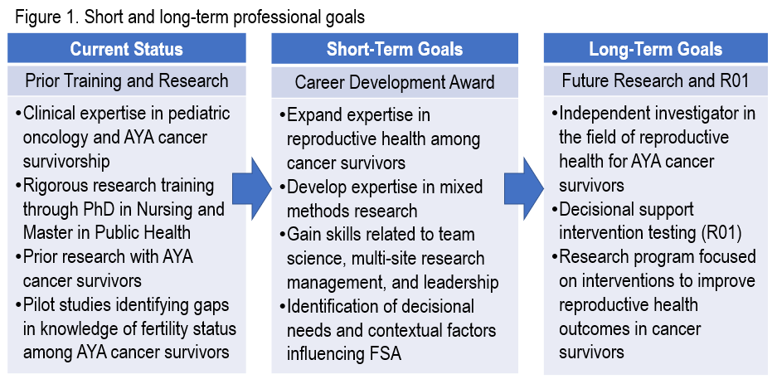
B. CAREER GOALS AND OBJECTIVES
Figure 1 illustrates my career goals trajectory to support further training via this K23. My 4 immediate goals are to: (1) Expand expertise in medical and psychosocial aspects of sexual and reproductive health in female cancer survivors; (2) Develop expertise in mixed methods research methodology, including the conduct of a multi-site research study; and (3) Gain skills related to team science, multi-site research management, and leadership necessary for independence as an investigator.

Slide 20
C. CANDIDATE’S PLAN FOR CAREER DEVELOPMENT/TRAINING ACTIVITIES
Training Aim 2: Develop expertise in mixed methods research
Training Need: I have experience conducting observational studies and quantitative analyses but require new skills for conducting studies that require rigorous mixed methods approaches.
Structured Activities: The Graduate Certificate in Applications of Mixed Methods Research through the University of Alabama at Birmingham provides structured coursework for building capacity in mixed methods research. As part of my doctoral education, I completed two of the required courses (NRM783 Foundations of Qualitative Research and NRM779 Mixed Methods Applications in Community-Based Action Research). This career development award will provide the opportunity to complete the remaining three courses in a distance-accessible format (NRM777 Mixed Methods Research I: Introduction to the Field, NRM778 Mixed Methods Research II: Designing & Conducting a Mixed Methods Study, and AH783 Writing Effective Mixed Methods Grant Proposal) and complete my graduate certificate. This coursework and graduate certificate will enhance my proficiency in mixed methods research. I will plan to attend a mixed methods research conference (e.g., Mixed Methods International Research Association conference) and submit an abstract for presentation.
Mentorship: I will acquire skills and experience with mixed methods research through quarterly focused mentor meetings with Dr. Ivankova, a renowned researcher in mixed methods at UAB.

Slide 21
REVIEWER COMMENTS 2. Career Development Plan/Career Goals & Objectives/Plan to Provide Mentoring
Strengths
Weaknesses
No formal evaluation of the candidate’s progress during the K99 has been outlined.
Not enough emphasis is placed on publication of data-driven peer-reviewed manuscripts.

Slide 22
Career Development Plan comments
Weaknesses
The applicant’s career development plan is weakened by an under-specified long-term goal. What is his main career objective? The reason that it is important to specify the long-term career objectives is that it may modify the ideal career development plan. (score = 5)
How will the coursework relate not only to the proposed plan but to the applicant’s long-term career goals? The amount of coursework may limit the amount of time she has to spend on a very ambitious research project.
Limited plans to learn new area of research, as candidate is already an expert in immunology techniques / theories. Recommend proposing new areas of training / education such as in signaling or fibrogenesis.

Slide 23
Career Development Plan comments
Training plan still includes a great deal of experiential learning, however does mesh well with specific aims and RBC survival could be critical for SCD patients.
What hands-on research experience will actually be provided?
Unclear how progress of the training plan will be evaluated

Slide 24
Reviewers’ Comments of the Training Plan
The plan follows a very nice mechanistic progression, has good background data in support of the aims, good scientific rigor, sample size calculations, and excellent data analysis plans. While the proposed research is somewhat ambitious, it is likely that Dr. R can achieve the aims.
This is the best career development plan I’ve ever read!

Slide 25
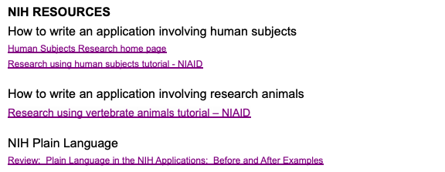
for Grant Writing
10 Tips for Successful Grant Writing
L. Taber (2018) The Chronicle of Higher Education
NIH Grant Applications The Anatomy of a Specific Aims Page
Michelle S. (2015) BioScience Writers
Richard McGee, PhD, CLIMB – Collaborative Learning and Integrated Mentoring in the Biosciences

