Slide 1
K-Club
Still the Boss: Part II—Lab Organization, Managing Grants, Publishing
3/11/2024

Slide 2
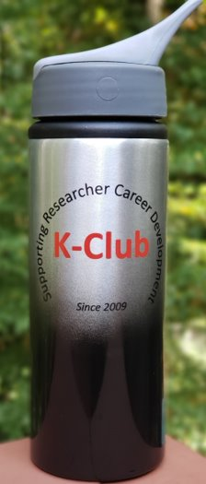
Survey Drawing

Slide 3
Survey Drawing
February Winner: Kimberly Dickinson

Slide 4
K-Club Special: The NCI Transition Career Development Award (K22 Independent Clinical Trial Optional)
Continuation of an NCI program to facilitate the transition of investigators in mentored, non-independent cancer research positions to independent faculty cancer research positions.
NCI will provide up to $100,000 per year toward the salary of the career award recipient plus fringe benefits. NCI will provide up to $50,000 per year toward the research development costs of the award recipient, which must be justified and consistent with the stage of development of the candidate and the proportion of time to be spent in research or career development activities. Indirect Costs are reimbursed at 8% of modified total direct costs.
Deadline: June 12, 2024 5 pm
More Information Here

Slide 5
K-Club Special: Pediatric Research Alliance JFF Grant
These grant opportunities are designed to prepare junior faculty to move from mentored research to independent researcher status. Each award is $50,000.
The principal investigator (PI) must have a current rank of Instructor or Assistant Professor in the Emory Department of Pediatrics or a member of the Peds Institute and be no more than 7 years into their faculty appointment.
The application must include a mentor and a mentee, as with an NIH K career development award.
The mentee serves as PI of the application.
The mentor fulfills the requirement for a second researcher.
The mentor must include a statement in the application on the applicant’s likelihood of being successful as an independent researcher.
​
LOI/Concept Form Deadline: April 11, 2024
More Information Here

Slide 6
K-Club Special: Free Grant Writing Workshop
This 12-week online training program will demystify the grant writing process and show you how to write a competitive research proposal
Video tutorials and guidance by Sarah Dobson, a research grant consultant who’s helped PIs bring in more than $40 Million in research funding in fiercely competitive environments like NIH and CIHR.
Tutorials range from "Creating Your Grant Writing Strategy" to "Getting Good Feedback" and more
Registration Deadline: March 14, 2024
More Information and Registration Here

Slide 7
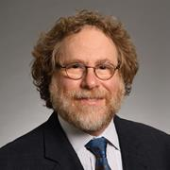
Still the Boss: Part II—Lab Organization, Managing Grants, Publishing
Jeremy Boss, PhD
Professor and Chair Department of Microbiology and Immunology Emory Chair in Basic Sciences Research Associate Dean for Basic Research Emory University School of Medicine

