Slide 1
K-Club
Strategies for Effective Poster Design
5/13/2024

Slide 2
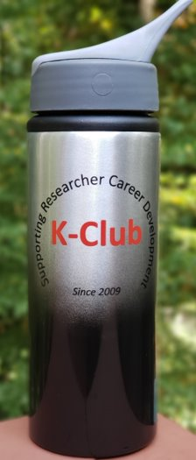
Survey Drawing

Slide 3
Survey Drawing
April Winner:
Christina Caruso

Slide 4
K-Club Special: Cannonball Kids’ cancer Foundation (CKc) Young Investigator Grant
The goal of CKc’s Young Investigator Grant is to fund research that:
Is within 2-3 years to translation to a clinical trial or is already associated with a clinical trial.
Is innovative.
Focuses on cancers that are either underfunded or under-researched.
Provides better quality of life or symptom relief than current treatments.
The Young Investigator Applicant for the proposed research must: 4
Have a medical doctoral degree: MD, DO, MD/PhD, or equivalent;
Be within 5 years of completing a training fellowship in Pediatric Hematology/Oncology or a closely related discipline that has direct clinical contact with pediatric cancer patients;
Hold an academic appointment at the instructor level or higher;
Be affiliated with a clinical department capable of supporting the proposed research
​
Up to $100,000 over 3 years
LOI/Concept Form Deadline: June 1, 2024
More Information Here

Slide 5
K-Club Special: Small Business Transition Grant for New Entrepreneurs (R41/R42 Clinical Trial Required)
This NOFO supports early-career scientists and health professionals interested in transitioning to a small business to gain industry experience, receive entrepreneurial training and mentorship, and advance biomedical technology with commercial potential as a PD/PI
Eligibility of the contact PD/PI is limited to scientists, engineers, and health professionals, including certain late-stage students, postdoctoral fellows or associates, and clinicians, who are new to research entrepreneurship and have not independently led significant research programs
The opportunity includes (and requires) both mentorship and entrepeneurship training
Total funding support (direct costs, indirect costs, fee) normally may not exceed $306,872 for Phase I awards and $2,045,816 for Phase II awards.
​
Deadline: September 5, 2024
More Information Here

Slide 6
April K-Club

Slide 7
Principles of Poster Design: Some Basics

Slide 8
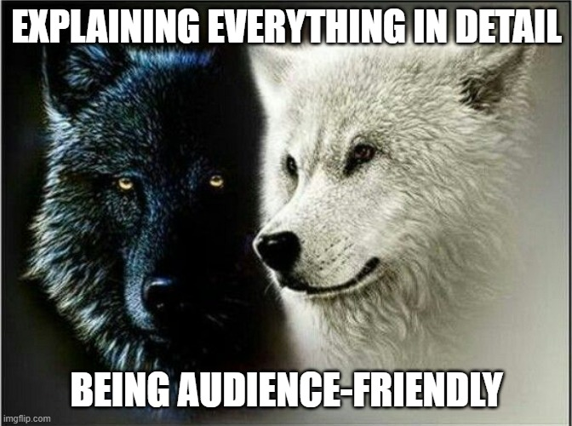
Poster Design Principle: Readability

Slide 9
Poster Design Principle: Readability
Contrast
Font size and style
White space
Amount of text
Sections
Color Choices

Slide 10
Poster Design Principle: Organization Essentials
Background
Objective
Methods
Results
Authors
Funding and References
Provide context for your audience
Provide concise description of your overall research objective
Without getting too detailed, describe your research methods
Provide a snapshot version of your results
Include all authors and denote lead author(s)
Don’t forget your required acknowledgements

Slide 11
Poster Design Principle: Organization Options
Other Possible Categories:
SMART Aim
Challenges or Limitations
Conclusions

Slide 12
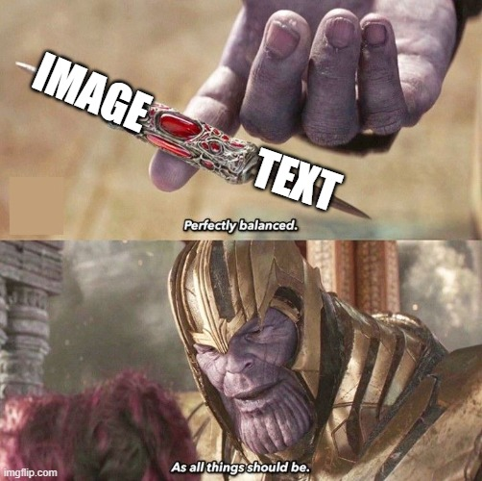
Poster Design Principle: Balance

Slide 13
Poster Design Principle: Figures
Figures should not be an afterthought
Figures should be clear in purpose
Figures should be produced by you or (even better) a scientific figure graphic designer
Figures should not be generated by AI

Slide 14
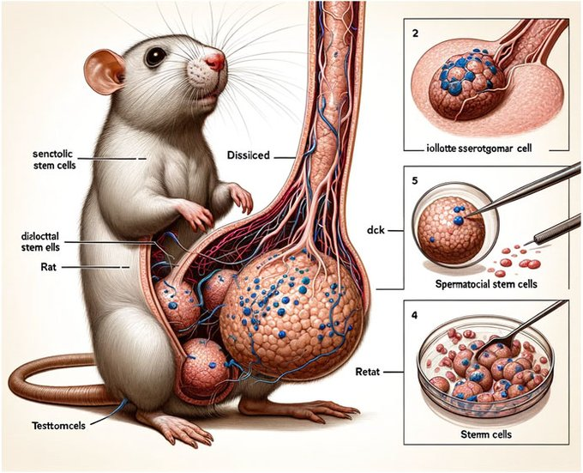
Poster Design Principle: Figures
Just Say No to Generative AI’s “Help” With Figures
Reported here: https://scienceintegritydigest.com/2024/02/15/the-rat-with-the-big-balls-and-enormous-penis-how-frontiers-published-a-paper-with-botched-ai-generated-images/

Slide 15
Poster Design Challenges

Slide 16
Poster Design Challenge: Audience Awareness
Who are you presenting to?
Is the poster’s audience experts in the specific field or a general biomedical or scientific audience?
What can you assume they will understand?
What do you need to explain in more detail?

Slide 17
Poster Design Challenge: Space Constraints
Know where to provide only high-level overviews
Know where to go into more detail
Figures are important to include, but only when they help make sense of information
Every detail should be doing important work

Slide 18
Poster Examples: Questions for Authors
What were the biggest challenges you faced when creating this poster?
Who was your primary audience?
What would you do differently for a more general audience? A more specific-to-your-area audience?
Explain your color choices
Explain your organizational structure
How did you decide how best to represent your data?
How did you approach labeling your figures?
Looking at your poster now, what, if anything, would you change about it?

Slide 19
Poster Examples: Elizabeth Sewell

Slide 20
Notes:
What were the biggest challenges you faced when creating this poster?
Who was your primary audience?
What would you do differently for a more general audience? A more specific-to-your-area audience?
Explain your color choices
Explain your organizational structure
How did you decide how best to represent your data?
How did you approach labeling your figures?
Looking at your poster now, what, if anything, would you change about it?

Slide 21
Notes:
What were the biggest challenges you faced when creating this poster?
Who was your primary audience?
What would you do differently for a more general audience? A more specific-to-your-area audience?
Explain your color choices
Explain your organizational structure
How did you decide how best to represent your data?
How did you approach labeling your figures?
Looking at your poster now, what, if anything, would you change about it?

Slide 22
Poster Examples: Ravi Patel

Slide 23
Notes:
What were the biggest challenges you faced when creating this poster?
Who was your primary audience?
What would you do differently for a more general audience? A more specific-to-your-area audience?
Explain your color choices
Explain your organizational structure
How did you decide how best to represent your data?
How did you approach labeling your figures?
Looking at your poster now, what, if anything, would you change about it?

Slide 24
Notes:
What were the biggest challenges you faced when creating this poster?
Who was your primary audience?
What would you do differently for a more general audience? A more specific-to-your-area audience?
Explain your color choices
Explain your organizational structure
How did you decide how best to represent your data?
How did you approach labeling your figures?
Looking at your poster now, what, if anything, would you change about it?

Slide 25
Poster Example: Chris Rees

Slide 27
Final Thoughts
Notes:
What were the biggest challenges you faced when creating this poster?
Who was your primary audience?
What would you do differently for a more general audience? A more specific-to-your-area audience?
Explain your color choices
Explain your organizational structure
How did you decide how best to represent your data?
How did you approach labeling your figures?
Looking at your poster now, what, if anything, would you change about it?

