Slide 1
How to Talk to Your Division Chief
10/8/2023

Slide 2
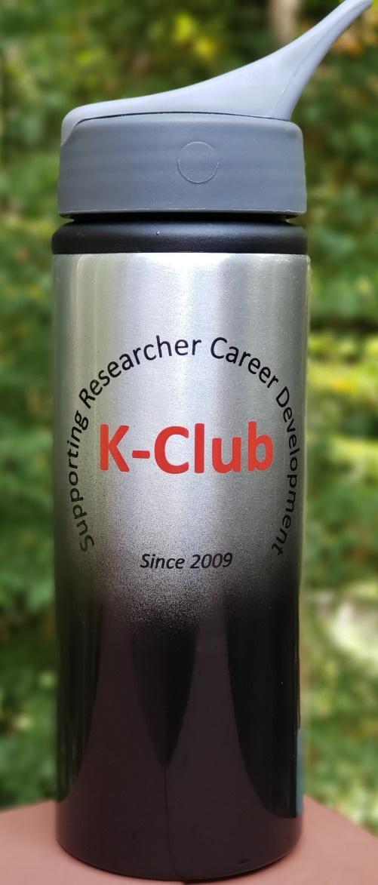




Survey Drawing

Slide 3
Survey Drawing
September Winner:
Michael Hochman

Slide 4
K-Club Special:
GEORGIA CTSA KL2 Program Application Workshop
The Georgia CTSA KL2 (Grant proposal is due February 1, 2024)
    Junior faculty from a wide variety of disciplines at the Georgia CTSA partner institutions: Emory University, Morehouse School of Medicine, Georgia Tech, and the University of Georgia. Per NIH rules, applicants must be U.S. Citizens or Permanent Residents
Free workshop in two parts that will provide a detailed review of the application process and advice on how to put together a competitive application
Part 1: October 19, 2023 9:30-11:30 am (hybrid format, though in person attendance is recommended)
Part 2: October 26, 2023 9:30-11:30 am (hybrid format, though in person attendance is recommended)
More Information Here

Slide 5
K-Club Special:
Damon Runyon Physician-Scientist Training Award
Physician-scientist applicants (MDs and DOs only) must have completed their residencies and clinical training, be U.S. Specialty Board eligible prior to the award start date, and be able to devote at least 80% of their time and effort to research. MD/PhDs are not eligible to apply. Applicants cannot be pursuing a PhD.
Candidates must apply with a Mentor.
This award will provide a funding source that will enable these individuals to pursue research intensively (at least 80% effort) for up to four years, while, if they wish to maintain their clinical skills, continuing to be clinically active (no more than 20% effort). In addition, the Foundation will retire up to $100,000 of any medical school debt still owed by an award recipient.
Deadline: December 1, 2023
More Information Here

Slide 6
K-Club Special:
American Society of Transplantation Career Development Grant
The purpose of these grants is to foster the training of early career investigators who have the potential to contribute to transplant science/immunobiology and/or treatment of transplant recipients. The grants encourage continued commitment of high-quality applicants to their careers in transplantation. Proposals must be in basic biomedical, disease-oriented, or translational research.
Only applications supporting research directly related to solid organ transplantation will be considered. Applications are accepted in basic, clinical, and translational research.
$75,000 a year for one or two years as budget allows.
Deadline: December 1, 2023
More information here

Slide 7
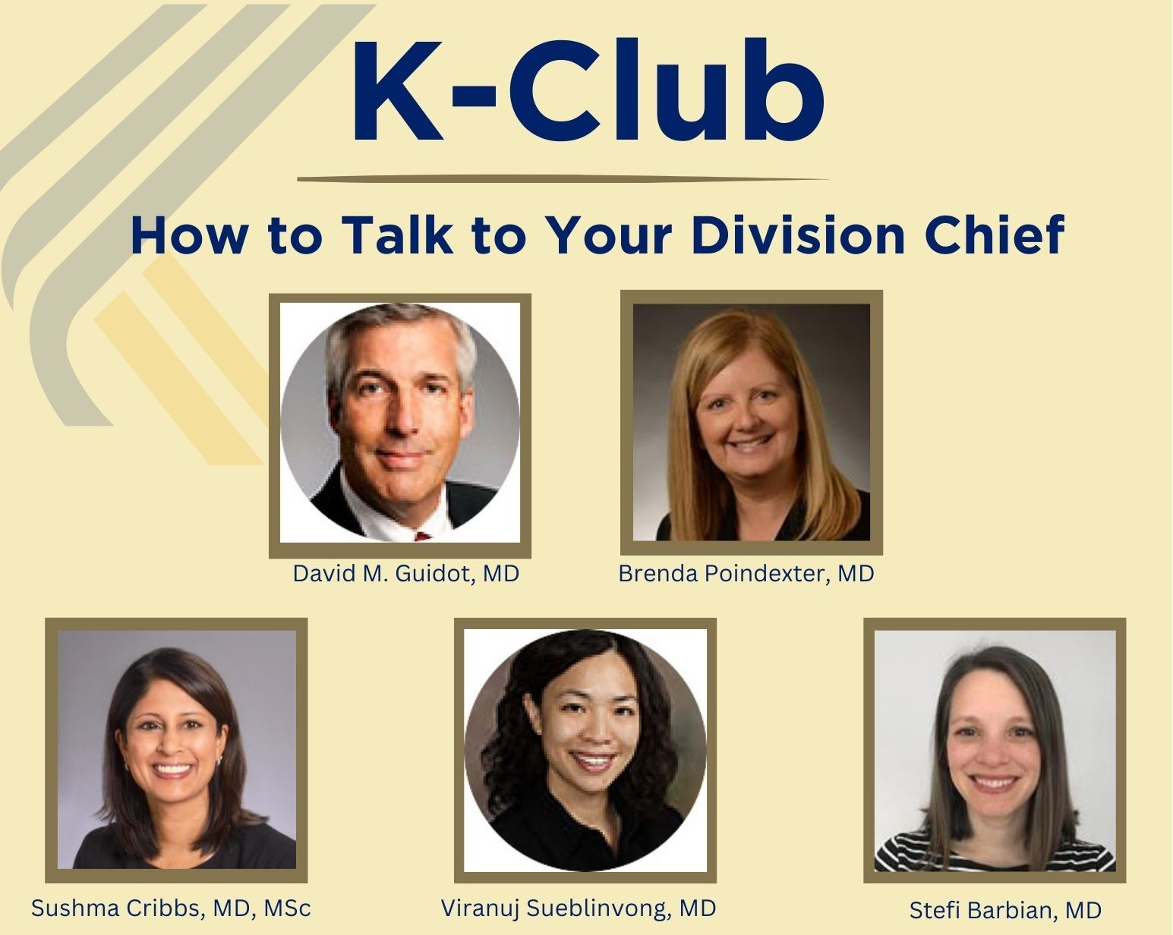
Today’s K-Club

Slide 8

What should prompt you to contact your Chief?
Periodic Updates
Career Development/Mentoring
Specific Requests

Slide 9
Career development/mentoring:
Navigating work-life balance and the stress of an academic career
Advice about a change in career focus and/or a change in academic track
Request for a change in FTE or FTE allocation
Promotion - how often should you be discussing this?
Help finding a mentor

Slide 10
Specific Requests
Request for funds – a project; a short-term course to enhance career/skills; travel
Letters of support – for a grant; nomination to a local or national committee or training program
To discuss salary and sometimes benefits
Help in resolving a conflict with a supervisor or peer
If you are exploring other employment
Help with manuscripts
Help with grant applications
Responding to grant reviews, especially if it has to do with title and/or institutional commitment
Notes:
https://grants.nih.gov/grants/how-to-apply-application-guide/forms-h/career-forms-h.pdf
Content: The mentor and co-mentor(s) (if applicable) must each document their role and willingness to participate in the project, and explain how they will contribute to the development of the candidate's research career. Each statement should include all of the following:
The plan for the candidate's training and research career development. Include information not only about research, but also about other developmental activities, such as seminars, scientific meetings, training in RCR, and presentations. Discuss expectations for publications over the entire period of the proposed project. Define what aspects of the proposed research project the candidate will be allowed to continue to pursue as part of his/her independent research program.
The source of anticipated support for the candidate’s research project for each year of the award period.
The nature and extent of supervision and mentoring of the candidate, and commitment to the candidate's development that will occur during the award period.
The candidate's anticipated teaching load for the award period (number and types of courses or seminars), clinical responsibilities, committee and administrative assignments, and the portion of time available for research.
A plan for transitioning the candidate from the mentored stage of his/her career to the independent investigator stage by the end of the project period of the award. Describe the mentor's (or co-mentor’s) previous experience as a mentor, including type of mentoring (e.g., graduate students, career development awardees, postdoctoral fellows), number of persons mentored, and career outcomes.
Note for co-mentor statements: Co-mentors must also address the nature of their role in the career development plan and how the responsibility for the candidate’s development is shared with the mentor. Describe respective areas of expertise and how they will be combined to enhance the candidate’s development. Also describe the nature of any resources that will be committed to this CDA.

Slide 11
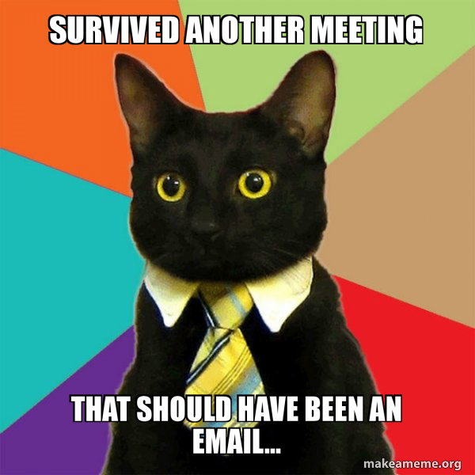
Email or Meeting?

Slide 12

Best Practices for Meeting with your Division Chief
  Prepare for the meeting - written agenda sent to them ahead of time for example
  Don't be late
  Be present and engaged during the meeting; turn off cell phone
  Send a follow up email recapping the conversation and next steps

Slide 13
General Dos and Don’ts
What is appropriate for you Division Chief to help you with and what isn’t?
What do they need/want to know?
What do they WANT to help you with and what do they not want to help you with?

Slide 14

Following the chain of command
Go to others first?
  Administrator?
  HR? (and if so, the situation probably depends so in what circumstances should you go to others first?)

Slide 15
For the K Awardees
  What is the best thing you learned from your chief?

Slide 16
To Chiefs
What do you know now that you wish you knew when you were just starting out in academic medicine?

