Slide 1
It Takes a Village: Assembling your Mentor/Co-Mentor and Consultant/Collaborator Teams for Your K application
9/18/2023

Slide 2
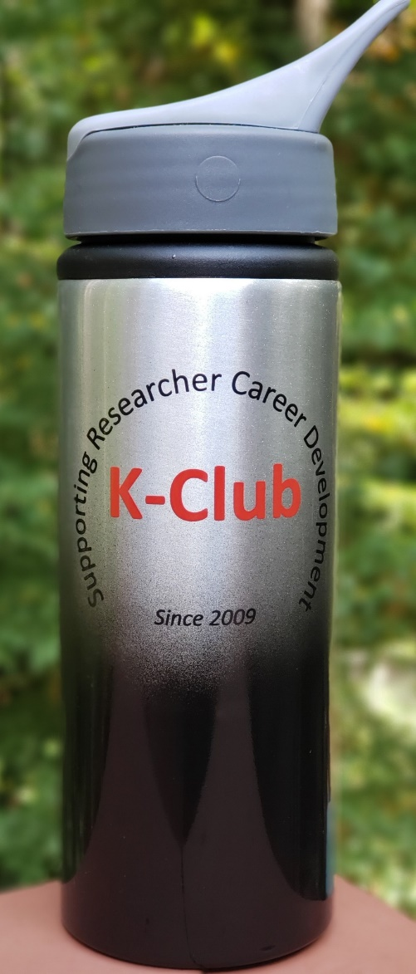
Survey Drawing

Slide 3
Survey Drawing
May Winner:
Ashwin Patel

Slide 4
K-Club Special: GEORGIA CTSA KL2 Program Application Workshop
The Georgia CTSA KL2 (Grant proposal is due February 1, 2024)
Junior faculty from a wide variety of disciplines at the Georgia CTSA partner institutions: Emory University, Morehouse School of Medicine, Georgia Tech, and the University of Georgia. Per NIH rules, applicants must be U.S. Citizens or Permanent Residents
Free workshop in two parts that will provide a detailed review of the application process and advice on how to put together a competitive application
Part 1: October 19, 2023 9:30-11:30 am (hybrid format, though in person attendance is recommended)
Part 2: October 26, 2023 9:30-11:30 am (hybrid format, though in person attendance is recommended)
More Information Here

Slide 5
K-Club Special: Conquer Cancer Career Development Award
The Conquer Cancer CDA provides research funding to clinical investigators, who have received their initial faculty appointment, as they work to establish an independent clinical cancer research program.
The mentored research must have a patient-oriented focus, including a clinical research study and/or translational research involving human subjects. Proposals with a predominant focus on in vitro or animal studies (even if clinically relevant) are not allowed.
Applicants must be a physician in the first to fourth year of a full-time primary faculty appointment and have completed productive postdoctoral research.
Must be able to commit 50% FTE in (total) research
Deadline: October 19, 2023
More Information Here

Slide 6
K-Club Special: Burroughs Wellcome Fund Career Award for Medical Scientists
(CAMS) is a highly competitive program for physician-scientists committed to an academic career. Its purpose is to bridge advanced postdoctoral/fellowship training and the early years of faculty service.
Proposals must be in the area of basic biomedical, disease-oriented, or translational research. Proposals in health services research or involving large-scale clinical trials are not eligible.
Candidates must hold an M.D., D.D.S., D.V.M., V.M.D., or D.O.
Candidates must have completed clinical training (residency or fellowship) and be board eligible by the award start date
Candidates can be Tenure track or non-tenure-track but must have a rank under Assistant Professor
Deadline: October 17, 2023 3 PM
More information here

Slide 7
K-Club: Sneak Peak for this Semester
9/18/2023:
Today!
Virtual noon start time
“It Takes a Village: Assembling your Mentor/Co-Mentor and Consultant/Collaborators teams for your K application“
10/9/2023
Virtual noon start time
“How to Talk to Your Division Chief”
11/2/2023
Thursday (instead of usual Monday)
In person (virtual option also available) noon start time – register for lunch!
"Conflict management with your research teams“ by special guest speaker Shari Barkin, MD, MSHS, Physician-in-chief, Chair, Dept of Pediatrics, Children’s Hospital of Richmond at VCU
12/11/2023
In person (virtual option also available) noon start time – register for lunch!
"Becoming the Boss: Tactical tips for getting your research program off the ground” by special guest speaker Jeremy M. Boss, Ph.D. Chair, Emory Department of Microbiology & Immunology

Slide 8
Today’s K-Club

Slide 9
K Grant Sections
Mentor, Co-Mentor, Consultant, Collaborators Section
8. Plans and Statements of Mentor and Co-Mentor(s) – 6 page limit
9. Letters of Support from Collaborators, Contributors, and Consultants – 6 page limit
Note that letters of support are not the same as letters of reference (also known as reference letters), which are required for some K applications. For more information about letters of reference, see the NIH's Reference Letters page.
From: https://grants.nih.gov/grants/how-to-apply-application-guide/forms-h/career-forms-h.pdf
Notes:
https://grants.nih.gov/grants/how-to-apply-application-guide/forms-h/career-forms-h.pdf

Slide 10
All necessary for a K Application
Mentor/ Co-mentor Plans & Statements
Letters of Reference
Collaborators Contributors Consultants Letters of Support

Slide 11
All necessary for a K Application
Mentor/ Co-mentor Plans & Statements
Letters of Reference
Collaborators Contributors Consultants Letters of Support

Slide 12
Mentor, Co-Mentor, Consultant, Collaborators Section
8. Plans and Statements of Mentor and Co-Mentor(s) – 6 page limit
Identify any and all co-mentors involved with the proposed research and career development program.
The mentor and each co-mentor must provide a statement to document their role and willingness to participate in the project, and explain how they will contribute to the development of the candidate's research career
Plan for training and research career development including info about research and other development activities (e.g. seminars, scientific meetings, training in RCR and presentations)
Publication plans and expectations
Define what aspects of the proposed research project the candidate will be allowed to continue to pursue as a part of their independent research program
Source of anticipated support during each year of the award period
Plan for transitioning the candidate to independence. Describe the mentor’s track record
Co-mentors must also address the nature of their role in the career development plan and how the responsibility for the candidate’s development is shared with the mentor. Describe respective areas of expertise and how they will be combined to enhance the candidate’s development
From: https://grants.nih.gov/grants/how-to-apply-application-guide/forms-h/career-forms-h.pdf
Notes:
https://grants.nih.gov/grants/how-to-apply-application-guide/forms-h/career-forms-h.pdf
Content: The mentor and co-mentor(s) (if applicable) must each document their role and willingness to participate in the project, and explain how they will contribute to the development of the candidate's research career. Each statement should include all of the following:
The plan for the candidate's training and research career development. Include information not only about research, but also about other developmental activities, such as seminars, scientific meetings, training in RCR, and presentations. Discuss expectations for publications over the entire period of the proposed project. Define what aspects of the proposed research project the candidate will be allowed to continue to pursue as part of his/her independent research program.
The source of anticipated support for the candidate’s research project for each year of the award period.
The nature and extent of supervision and mentoring of the candidate, and commitment to the candidate's development that will occur during the award period.
The candidate's anticipated teaching load for the award period (number and types of courses or seminars), clinical responsibilities, committee and administrative assignments, and the portion of time available for research.
A plan for transitioning the candidate from the mentored stage of his/her career to the independent investigator stage by the end of the project period of the award. Describe the mentor's (or co-mentor’s) previous experience as a mentor, including type of mentoring (e.g., graduate students, career development awardees, postdoctoral fellows), number of persons mentored, and career outcomes.
Note for co-mentor statements: Co-mentors must also address the nature of their role in the career development plan and how the responsibility for the candidate’s development is shared with the mentor. Describe respective areas of expertise and how they will be combined to enhance the candidate’s development. Also describe the nature of any resources that will be committed to this CDA.

Slide 13
Assembling Your Mentor Team – satisfying all the needs
Criteria that must be met collectively
Funding/Stability – ideally NIH funding for period of the K
Time considerations
Aligned research interests (but not too aligned…)
Strong Biosketch showcasing personal success in scholarship as measured by grants, papers, and overall reputation
Demonstrated track record and commitment to mentoring and career development
Some general rules of thumb
Assemble a team with complementary strengths
Choose a primary mentor who is a senior investigator with a track-record of NIH funding
Include co-mentors to complement the primary mentor’s strengths and counter-balance any weaknesses
Establish a relatively small (2-4) mentoring team
Ensure consistency with the grant application text and specify frequency of meetings, goals/planned deliverables and evaluation measures, resources and tools, ownership of research area
People with a relatively narrow area of responsibility and focus should instead be in the collaborator, consultant, contributor section

Slide 14
Assembling Your Mentor Team
How did you meet your mentors?
How many people are on your core mentor team?
What roles does each play?
Were these criteria collectively met? How did you shore up any potential shortcomings?
Funding/Stability – ideally NIH funded for period of the K
Time considerations
Aligned research interests
Strong Biosketch showcasing personal success in scholarship as measured by grants, papers, and overall reputation
Commitment to mentoring and career development

Slide 15
All necessary for a K Application
Mentor/ Co-mentor Plans & Statements
Letters of Reference
Collaborators Contributors Consultants Letters of Support

Slide 16
Mentor, Co-Mentor, Consultant, Collaborators Section
9. Letters of Support from Collaborators, Contributors, and Consultants – 6 page limit
Required for any such person who will contribute to the scientific development or execution of CDA application’s proposed project
For those contributing in a substantive, measurable way to the scientific and/or career development or execution of the project
Briefly describe their anticipated contributions and document their role and willingness to participate in the project
Briefly describe research materials, data, guidance, or advice each person will provide
Consultant letters should include rates/charges for consulting services
From: https://grants.nih.gov/grants/how-to-apply-application-guide/forms-h/career-forms-h.pdf
Notes:
https://grants.nih.gov/grants/how-to-apply-application-guide/forms-h/career-forms-h.pdf
9. Letters of Support from Collaborators, Contributors, and Consultants
Note that letters of support are not the same as letters of reference (also known as reference letters), which are required for some K applications. For more information about letters of reference, see the NIH's Reference Letters page.
From whom are letters of support required? From whom are letters not required?
Letters of support from collaborators, contributors, and consultants will be required for any such person who will contribute to the scientific development or execution of CDA application’s proposed project. Follow the requirements for letters of support as listed in the FOA. Letters are not required for personnel (such as research assistants) not contributing in a substantive, measurable way to the scientific development or execution of the project
Content:
Letters from consultants should include rates/charges for consulting services.
Mentored CDA applications should identify collaborators, contributors, and consultants involved with the proposed research and career development program, and not already included in the “Plans and Statements of Mentor(s) and Co-Mentor(s)” section. Letters should briefly describe their anticipated contributions and document their role and willingness to participate in the project. The letters should also briefly describe research materials, data, guidance, or advice each person will provide.

Slide 17
Your collaborators, contributors and consultants
Who were they and how did they round out your plans for career development?
How did you meet them and how did you ask them to serve in this official role?
How many did you have and what were the specific things they offered to you/brought to the table?

Slide 18
Grantsmanship Considerations
Did you draft the letters for them?
How did you incorporate/reiterate their roles and contributions to your project and career development in other sections of your grant? (Biosketches? Resources and environment? Career Development Plan? Research Strategy?)
For resubmissions: What adjustments did you need to make or grantsmanship strategies did you employ to respond to reviewer concerns?

Slide 19
Post Funding Reality
Beyond grantsmanship, how did these people contribute to your actual application (did your mentors review the entire application before submission, for example)?
How has the operationalization of these groups gone since you have been funded? Is it working out as you had designed? What adjustments/pivots have you had to make?
How often do you meet formally and is there a planned agenda?
Can you share any potential pitfalls and lessons learned from your experience?

