Slide 1
Conflict Management with your Research Teams
11/2/2023

Slide 2
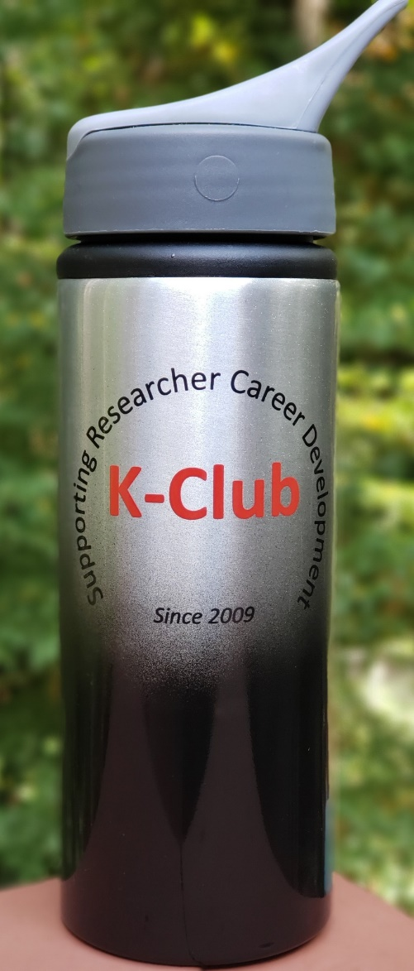
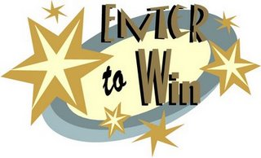
Survey Drawing

Slide 3
Survey Drawing
September Winner:
Seyma Katrinli

Slide 4
K-Club Special: Mentored Career Development Award to Promote Faculty Diversity in Biomedical Research (K01 Independent Clinical Trial Required)
This FOA is designed specifically for candidates proposing to serve as the lead investigator of an independent clinical trial, a clinical trial feasibility study, or a separate ancillary clinical trial, as part of their research and career development.
NIH will contribute up to $100,000 per year toward the salary of the career award recipient. NHLBI will contribute up to $30,000 per year toward the research development costs of the award recipient, which must be justified and consistent with the stage of development of the candidate and the proportion of time to be spent in research or career development activities.
Deadline: February 13, 2024, by 5:00
More Information Here

Slide 5
K-Club Special: University Research Committee (URC) Grants 2024-25 Cycle
The URC promotes rigorous and innovative scholarship in all academic disciplines to benefit the Emory community and beyond. The URC supports:
• Early career faculty on their path toward research independence
• More advanced faculty who wish to engage novel questions that enhance their expertise
• Teams of faculty who seek to transcend the boundaries of their respective disciplines and undertake transformative research
Except for the Interdisciplinary category, award maximums are $30,000, and most URC proposals will have only one principal investigator (PI). Interdisciplinary proposals with two or more PIs may request up to $40,000 per award.
Deadline: January 17, 2024 11 pm
More Information Here

Slide 6
Today’s K-Club

Slide 7
Conflict Management: Building Tools and Knowing When to Use Them
Shari Barkin, MD, MSHS
Jesse Ball DuPont Endowed Chair
Professor of Pediatrics
Chair Department of Pediatrics
Physician-in-Chief
Fall 2023

Slide 8
What is Conflict Management?
The process of minimizing negative results while emphasizing the potential positive outcome
5 Most Effective Conflict Management Styles (and when to use each one). Mary Clare Novak, May 2019

Slide 10
When to Accommodate used when you set aside you own wants/needs and focus on others
When you are wrong
When you don’t care about the issue as much as the other person
When there is no point in arguing

Slide 11
When to Avoid ignoring the situation completely
When conflict is meaningless
When you don’t have time to manage conflict
When you aren’t sure what you think about the issue yet

Slide 12
When to Compromise trying to find a way to partially satisfy people on both sides of the argument
When reaching a solution is more important than the solution itself
When you need a temporary solution
When you are at an impasse

Slide 13
When to Collaborate finding a solution that will completely appease all involved a win-win solution
When the relationship is important
When the final solution will have a significant impact
When the interests, needs, and beliefs of all parties need to be included

Slide 14
When to Compete taking a firm stance and getting what you want
When you have to stand up for yourself, your rights, your values
When a less forceful style is ineffective
When nothing else is working

Slide 15
Sometimes you just need to ASK
Don’t assume that the other person knows what you need
Don’t assume that needed things will be forthcoming
Don’t assume you’ll be turned down

Slide 16
Principled Negotiation meets Conflict Resolution
Goal: Achieve wise outcomes efficiently while maintaining relationships
Developed by the Harvard Negotiation Project
Summarized in Fisher and Ury
Getting to Yes: Negotiating Agreement Without Giving In, 2nd ed.

Slide 17
https://www.youtube.com/watch?v=0CdixDzE7I0

Slide 18
Strategies
Separate the people from the problem
Understand each others interests--then negotiate interests, NOT positions
Invent options for mutual gain
Use objective criteria

Slide 19
Separate people and problems
Uncover your own assumptions about motivation and past behavior
Understand each person’s view of the facts
Acknowledge emotions

Slide 20
Explore interests
Get clear on goals
What do each of you want?
What is in common, what is in conflict?
What are each person’s constraints?

Slide 21
Invent options for mutual gain
Brainstorm without judgment--be creative
Engage experience--what have they done in the past?
Look for items that are low cost to you and high benefit to them and vice versa

Slide 22
Use objective criteria
Important when interests are opposed
Sometimes can agree in advance to be bound by these criteria

Slide 23
Preparing for conflict resolution
Determine your interests
Determine their interests
Brainstorm possible solutions--talk to colleagues and mentors
Rehearse! Rehearse! Rehearse!
Know your BATNA

Slide 24
What’s a BATNA??
B est
A lternative
T o
N egotiated
A greement

Slide 25
Knowing your BATNA
Make a list of options if you can’t reach agreement (must be real!)
What would happen if you didn’t negotiate/resolve conflict?
Helps you to avoid agreeing to something you don’t want
The better your BATNA, the greater your power

Slide 26
What if it’s not working?
Try negotiation Jujitsu
Use the other person’s force against them
Strategies
Don’t attack a position--look for underlying interests
Ask for criticism and advice
If personally attacked--let them vent, then reframe so attack is on the problem
Ask questions/permission

Slide 27
Barriers for Cooperation
Your reaction: When you hear NO, you feel attacked, devalued and you may want to strike back!
Their emotion: Behind the attack may be negative emotions such as jealousy or hostility
Their position: In joint problem solving you try to face the problem together rather than taking opposite positions. The other side may have a long tradition of “digging in” and any outcome other than what they thought should happen before the conversation started is considered a failure on their part

Slide 28
Natural Reactions
Striking back: Leads to futile and costly confrontation. Rarely advances your interests and damages long-term relationships.
Giving In: You appear weak and you reward the other side for bad behavior
Breaking off: Usually a hasty reaction that you regret later.
Danger of reacting : Lose site of our interests and objectivity

Slide 29
Strategies when you think you are under attack
Put on your radar not your armor
Make a mental note when you think there is a possible attack -- look for additional evidence
Go to the balcony
It may help to see the person as someone who doesn’t know better
Buy time to think, pause or rewind the tape: “Let me make sure that I understand what you are saying…” Take a time out.

Slide 30
The Breakthrough Negotiation
Rather than pounding your idea in, you encourage the person to reach for it from within.
Rather than pressuring someone to change their mind, create an environment in which they can learn
Only they can break through their own resistance, your job is to help them

Slide 31
The Steps
The first barrier is your natural reaction --suspend it! Regain your mental balance, don’t lose sight of the goal. Go to the balcony, distance yourself from your natural reaction
Overcome the other side’s negative reaction -- don’t get drawn into an argument. They expect you to be adversarial, instead try to listen, take their side, try to understand their position, be respectful. Step to their side

Slide 32
The steps
Try to tackle the problem together, this is hard if they are digging in. Accept what they say and reframe it as an attempt to deal with the problem. Ask questions about the problem. “Ok, I understand that the division is having financial problems this year and no one is getting raises, but this salary differential is not equitable, are there other sources for compensation that we could consider? ”
Try to bridge the gap between their position and yours. Help them save face and make the outcome look like a victory for them. Build a golden bridge

Slide 33
The steps
Despite your best efforts the other side may still refuse to cooperate believing that they can beat you at the power game. Use power not to escalate but to educate. Show them that they cannot win alone but only together and try to bring them back to the table. Use power to educate.

Slide 34
Step to their side
Secret of disarming is surprise, do the opposite of what is expected
Listen - actively
Acknowledge - shows respect
Agree - even if only on small parts
Once the other side has been heard they will be less reactive
Project confidence, remain calm, make eye contact, accumulate “yeses”

Slide 35
Reframing
Don’t reject -- change the game
Redirect the other side’s attention away from fixed positions toward the task of identifying interests, creating options, and discussing fair standards for selecting an option
Ask problem solving questions
How you ask is just as important as what you ask --- use “we”

Slide 36
Obstacles to Agreement
Not their idea
Unmet interests
Fear of losing face
Too much too fast

Slide 37
Build them a golden bridge
Start from where they are and try to make it easy to get over the obstacles
Involve the other side in finding a solution
Ask for and build on their ideas
Offer choices -- go slow
Try to satisfy some unmet interests
Help them save face

