Slide 1
Take Two: Strategies for Resubmissions of Grant Proposals
3/13/2023

Slide 2
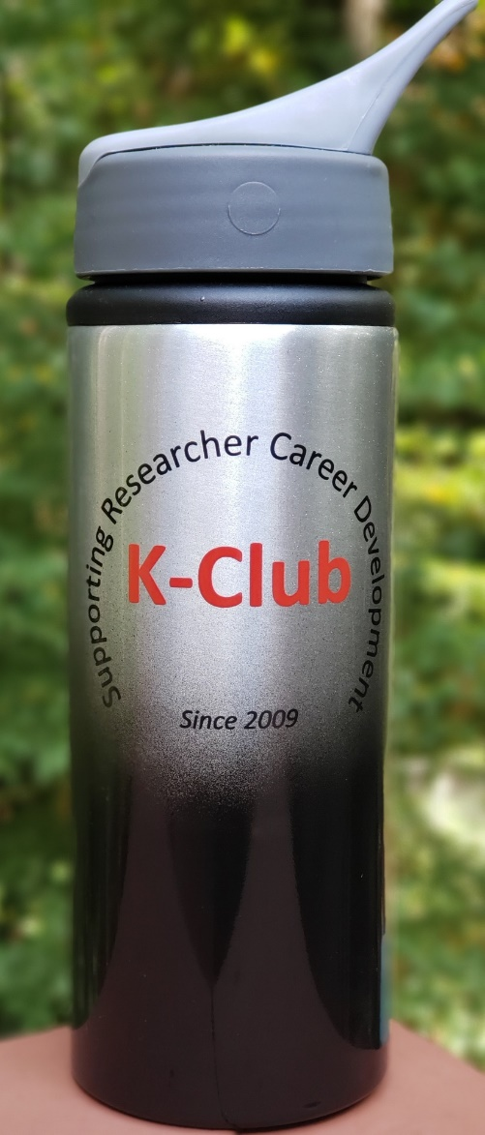
Survey Drawing

Slide 3
Survey Drawing
Winner: Samillya Pearson!

Slide 4
K-Club Special: International Anesthesia Research Society (IARS) Mentored Research Award
The IARS Mentored Research Awards (IMRA) are intended to support investigations that will further the understanding of clinical practice in anesthesiology and related sciences
Up to $175,000 payable over two (2) years
The proposed project may be in any area of investigation (clinical, translational, basic science), but must have ultimate relevance to the broad practice of anesthesiology and its subspecialties.
Principal applicants for IMRA must be members of the IARS who have yet to establish substantial independent research funding or who are initiating a new area of research. Candidates should present a clear research plan, propose work that is pertinent to anesthesiology, and have both a senior mentor and an appointment in a successful principal investigator’s group.
Deadline: April 30, 2023
https://iars.org/wp-content/uploads/IMRA-Guidelines2023.pdf

Slide 5
K-Club Special: DoD Autism Career Development Award
The proposed research is expected to make an important and original contribution to advancing the understanding of ASD and ultimately lead to improved outcomes for individuals with ASD and their families/caregivers. The project’s impact on both ASD research and ASD care should be clearly articulated. A statistical plan is an important aspect of the FY23 ARP Career Development Award to demonstrate the significance of any research outcomes or findings.
The FY23 ARP Career Development Award is designed to support the continued development of promising independent investigators that are early in their faculty appointments or the transition of established investigators from other research fields into a career in the field of ASD research. Applicants are strongly encouraged to strengthen their applications through collaboration with investigators experienced in ASD research and/or possessing other relevant expertise as demonstrated by a record of funding and publications.
Up to $550,000 over a three-year period
Deadline: July 20, 2023
https://www.grants.gov/custom/viewOppDetails.jsp?oppId=346592

Slide 6
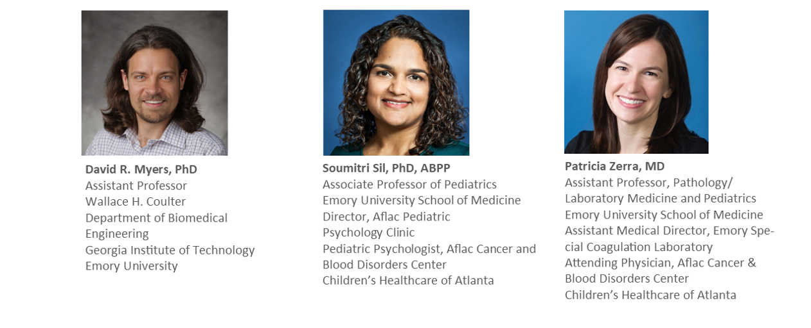
Panelists
Notes:
David R. Myers is currently an Assistant Professor in the Wallace H. Coulter Department of Biomedical Engineering at Georgia Tech and Emory University. David leads the Sensors for Living Systems Lab, which fuses engineering, microsystem design, biology, and clinical research. Working at the intersection of these fields, David has authored or contributed to publications in Nature Materials, Nature Communications, PNAS, and Blood.
Soumitri Sil, PhD, ABPP
Dr. Soumitri Sil is an Associate Professor of Pediatrics at Emory University School of Medicine and Director of the Pediatric Psychology Clinic for the Aflac Cancer and Blood Disorders Center at Children’s Healthcare of Atlanta. Her clinical research program in pediatric pain broadly centers on the assessment and treatment of chronic pain in pediatric sickle cell disease focused on addressing health disparities. Her K23 award focused on identifying individual and family psychosocial factors that contribute to the onset and maintenance of chronic sickle cell pain and developing and evaluating a culturally-responsive behavioral intervention for adolescents with chronic pain related to sickle cell disease. Dr. Sil was awarded an R03 to build on her K23 work to evaluate behavioral treatment effects on reducing inflammatory biomarkers associated with pain. She was recently awarded an R61/R33 award through the NIH HEAL Initiative to adapt and test a multicomponent behavioral intervention for chronic sickle cell pain through a multi-site RCT.
Patricia Zerra, MD is Assistant Professor in the Department of Pathology and Laboratory Medicine at Emory University and is the Assistant Medical Director of the Special Coagulation Laboratory at Emory University Hospital. She has a secondary appointment in the Aflac Cancer & Blood Disorders Center at Children’s Healthcare of Atlanta where she sees pediatric hematology patients. Dr. Zerra’s lab focuses on identifying the immune mechanisms underlying the development of antibodies against blood-borne therapeutics, including red blood cells and factor VIII.

Slide 7
Overall Strategy for the Resubmission Process
Read and digest the reviewer comments
Formulate the revision strategies
Craft the introduction to resubmission

Slide 8
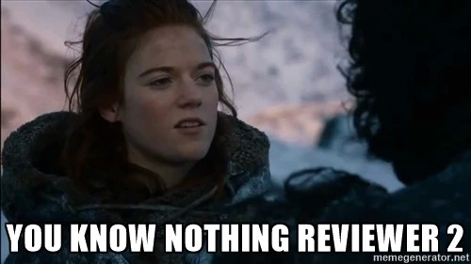
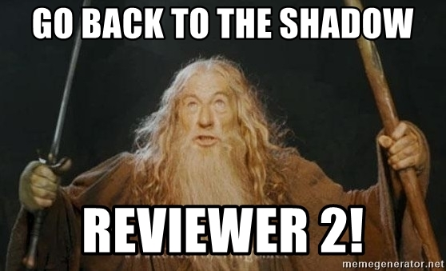
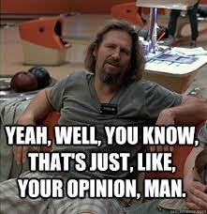
Reading and Digesting the Reviewer Comments
The stages of digesting reviewer comments, while not linear, include the following:
Slightly overblown sense of confidence
Anger/Defiance
The reluctant beginnings of acceptance

Slide 9
Reading and Digesting the Reviewer Comments
The Ultimate Goal:
Excited Acceptance and Readiness to Conquer!

Slide 10
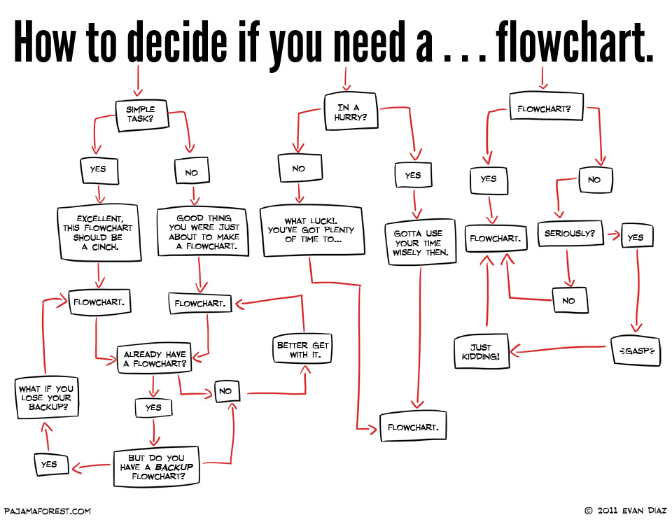
Reading and Digesting the Reviewer Comments
So to the panelists:
How did you get to the “excited acceptance and readiness to conquer” stage?
How did you work through the earlier stages?
How did you decide which comments touched on an issue you really did need to significantly revise and which ones you might need simply to justify keeping as is in your introduction letter to the resubmission application?

Slide 11
Reading and Digesting the Reviewer Comments
Other Considerations:
Did you have a strategy to divide the revision suggestions into categories, and what criteria did you use for that?
For example: did you think of it in terms of section of the application or global revision suggestions vs localized revision suggestions or some other system?
Did the reviewers themselves help you in categorizing in the way that they structured their comments?
Were there any comments that you expected to get? If so, had you already started preparing to address those?

Slide 12
Formulating the Revision Strategy
Once you were ready to start planning your revisions, what is the first thing you did? How did you organize your thoughts on how to approach the process?
Just like the writing process, revision is not always a linear endeavor, but rather recursive. Can you describe what it looked like for you?

Slide 13
Crafting the Introduction to Resubmission
Describe how difficult this part was for you. (There’s no right answer here—no tricks. Some people probably find this part easy and others quite difficult.) What was the hardest part of it?
The introduction to resubmission is limited to just one page. That means every word counts as you encapsulate your entire strategy as concisely as possible. How did you prioritize things? What aspects did you prioritize towards the top and why? What aspects got sacrificed and why?

Slide 14
Crafting the Introduction to Resubmission
I deeply appreciate the detailed examination and constructive comments, the reviewers offered for this application, specifically “Candidate was well regarded”, “logical and well-organized training plan”, “mentors are outstanding and appropriate”, “environment and resources … are excellent”, “The PI proposes a new and potentially exciting diagnostic tool for use in assessing bleeding disorders”, and with suggested changes that “the reviewers were confident that this could be a strong application.” The theme of the concerns of the reviewers largely centered around the need for greater and more detailed development of the clinical research methodology and translational aspects of moving the microchip to the bedside. These changes are now incorporated into the revised proposal as detailed below. Changes in the text of the proposal have been indicated with a bar in the left margin.
-David Myers, K25
Can you walk us through some of your strategies in this paragraph? How were you envisioning your audience, and what was the gist of what you wanted to communicate to them in the very first paragraph of this introduction?
What do you see as the most important component of this paragraph?
Notes:
I can tell you what I like about this first paragraph of the introduction to resubmission, but I think we would all rather hear you discuss what you were going for here, David.

Slide 15
Crafting the Introduction to Resubmission
Candidate. “Relatively new to the management of patients with SCD.” “No publications with primary mentor.” Although my transition to SCD pain management has been recent, I have successfully published new first authored papers with my primary co-mentors (Dampier and Cohen) in SCD pain since my last submission, with 3 publications in SCD and 2 manuscripts under review. I also received highly competitive internal pilot funding
supported by Emory’s NIH-funded CTSA, which directly supports my programmatic line of SCD pain research and the revision of this proposal.
-Soumitri Sil, K23
Often, academics struggle to adequately sell themselves in documents that require it. I think this concise paragraph does a great job of doing that. What did you choose to prioritize here to show that you had gained the experience you needed? Did you choose to omit any achievements here that did not quite fit?
This also shows that sometimes—perhaps quite often—revision happens substantively, over a long period of time and had not much to do with the actual strategy of revising. You needed more experience, and you got it. Did you expect this comment when you received it after your first submission?

Slide 16
Crafting the Introduction to Resubmission
Research Plan: R#1: “The clinical significance might lessen as alternatives … continue to demonstrate success”. While emicizumab prophylaxis can reduce bleeding risk, it is not optimal for managing acute hemorrhage. Furthermore, neutralizing antibodies have also been reported against emicizumab. These
points highlight the importance of inhibitor prevention and defining mechanisms of anti-drug antibody formation in general. Using FVIII inhibitor formation as a model of adjuvant independent immune responses may therefore not only aid in understanding inhibitor formation, but also antibody formation to other blood-borne therapeutics.
-Patricia Zerra, K08, references redacted
This reviewer comment (in quotation marks) struck me as a bit of a “Reviewer 2” situation, despite coming from the literal Reviewer 1. Can you walk us through your process from first seeing that comment to the final response we have here? How important was it to you to respond firmly without backing down, which is what it seems to me you have done here?
Was there even a revision that could be made to this at all or was this so central to the project that revision would have meant starting from scratch?

Slide 17
Final Thoughts
What is the most important piece of advice you can give someone working on a resubmission?
If you had it to do over again, is there anything you would change about your process?
Questions from participants!

